Slide 1

Fast and scalable 3d cell tracking and unsupervised motion phenotype discovery
A Progress Report…
March. 20. 2019

Slide 2
Agenda
A brief introduction about T. gondii
3D Microscopic video challenges
Serial Computational Pipeline ( cell detection and Tracking)
Framework Parallelization
The Dask version of the framework
3D trajectories Clustering
Conclusion and Future works

Slide 3

Toxoplasma gondii
an intracellular parasite that invades host cells, hijacks the cellular machinery, and replicates before egress and subsequent invasion
the causative agent of disseminated toxoplasmosis, which is considered as one of the most successful parasitic infections; more than 1/3 of the world’s population has been or is infected.
For infants, elderly, neonatal fetuses, and individuals with weak or compromised immune systems, T. gondii can cause deadly complications.
T. gondii’s virulence and ability to invade host cells is linked to its lytic cycle.
The image is downloaded from https://www.istockphoto.com/photo/toxoplasma-gondii-awareness-conceptual-image-gm874063668-244075790

Slide 4
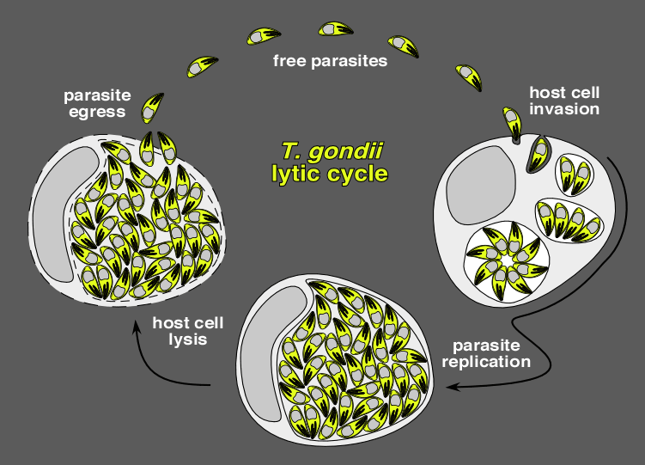
Why we study the Moyility of the parasite ?
Motility is essential for lytic cycle because :
Move to find a host cell to invade
The actual process of invasion to go into a host cell
Egress out of a host cell
By modeling the motion of T. gondii, we will be able to answer some fundamental questions, like:
what are the fundamental motion phenotypes of T. gondii?
Are specific motion patterns associated with certain drugs? If so, what is their molecular basis?
And, ultimately, how could we design targeted therapies to disrupt the T. gondii lytic cycle and target the gliding, invading, or egress stages of the parasite?

Slide 5
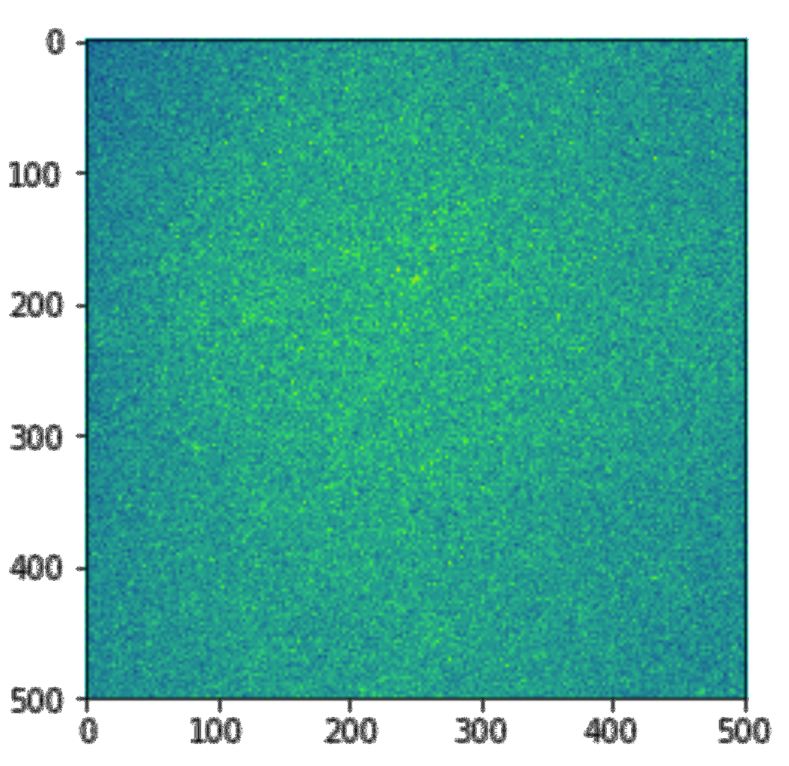
3D Microscopic video challenges
Low quality images.
Difficulties on detections.
Large data sets.
Frame 1
Frame 2
Frame n

Slide 6
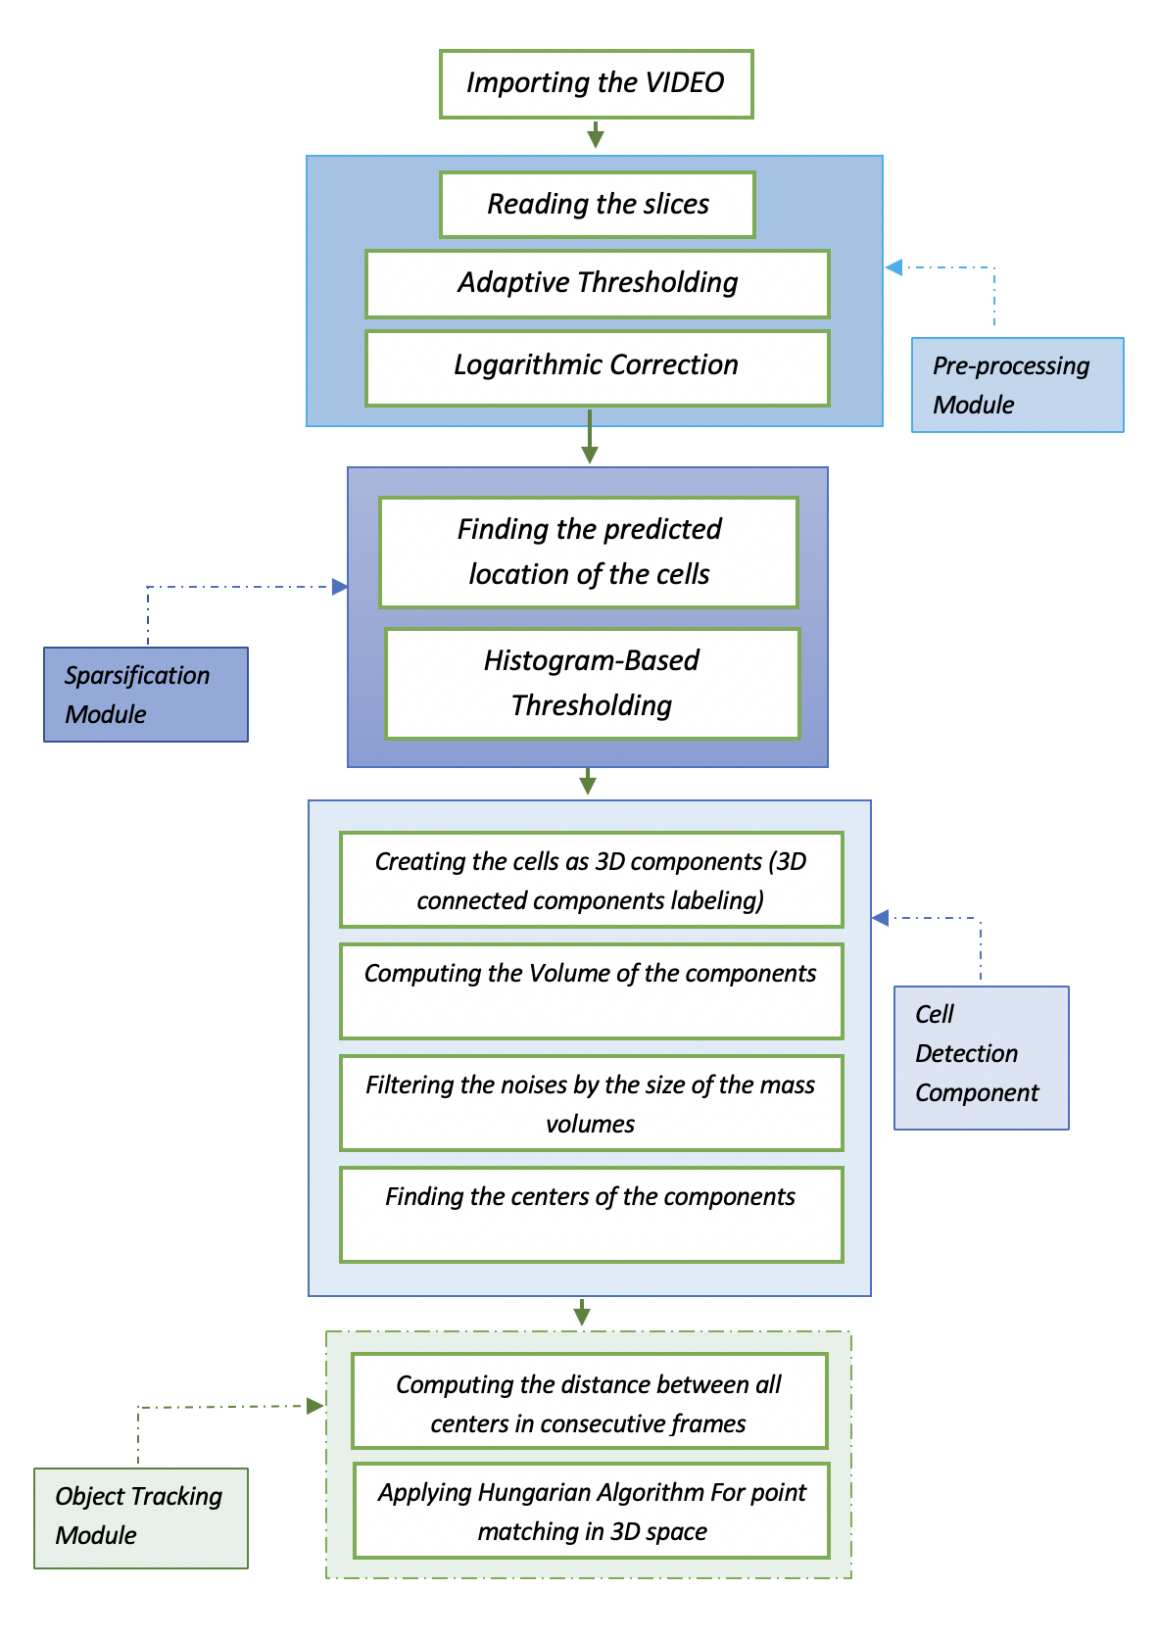
Serial Computational Pipeline:

Slide 7
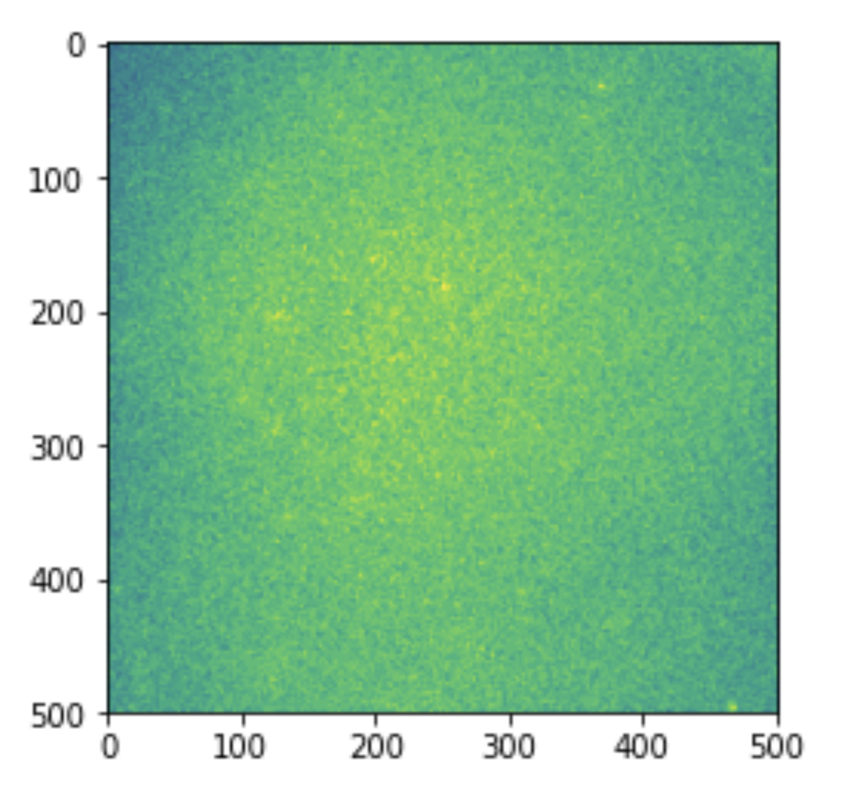
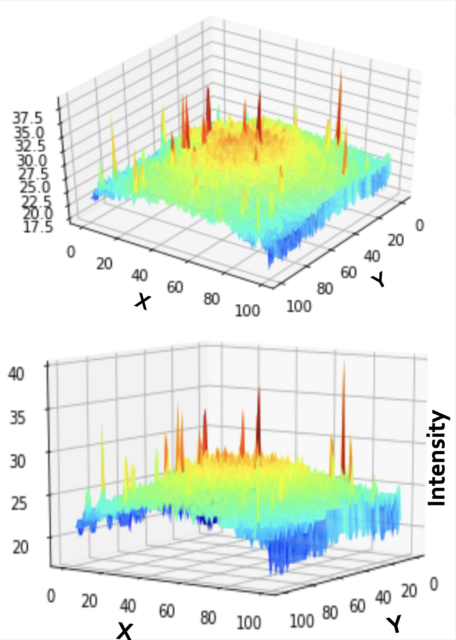
Preprocessing
The effect of dark corners

Slide 8
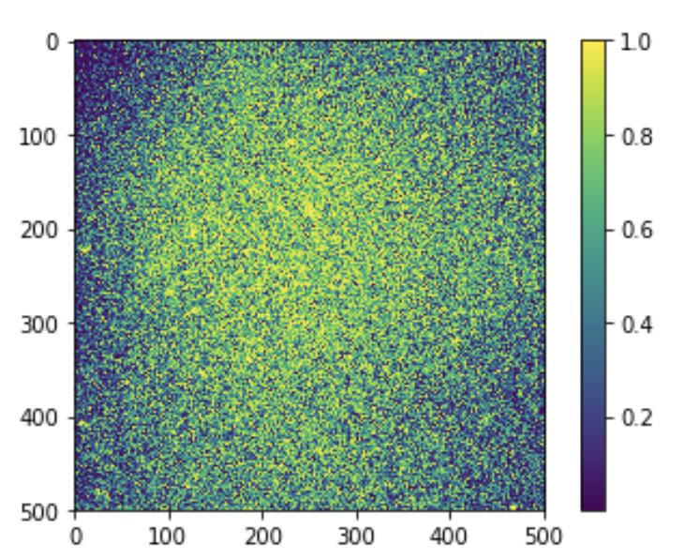
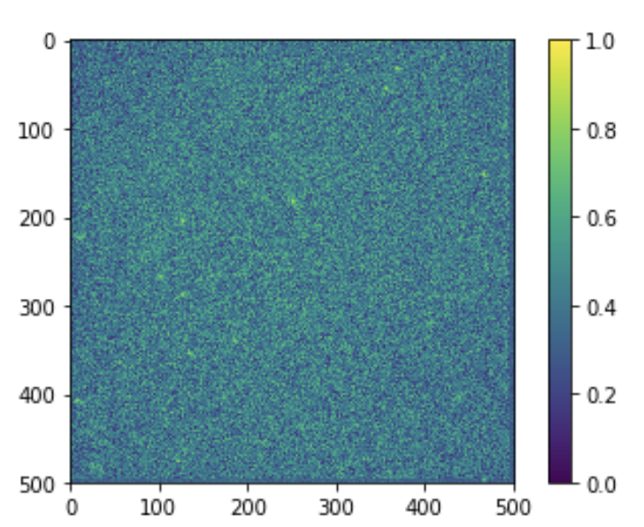
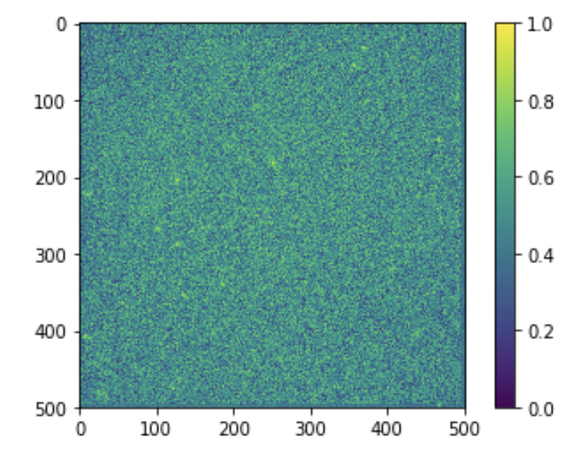
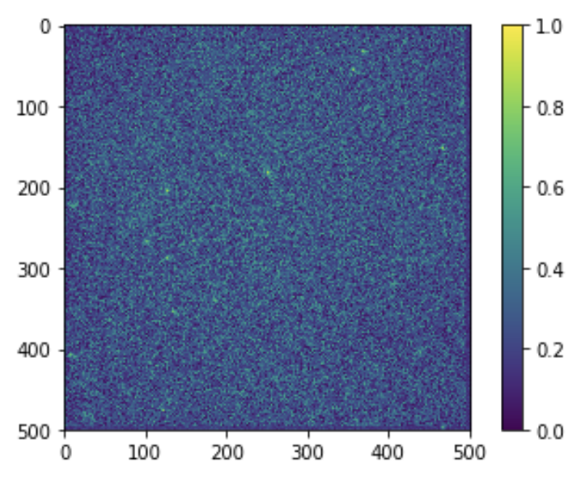
Preprocessing
Is there a way to decrease the effect of dark corners ?
Adaptive Thresh
Logarithmic Correction
Gamma correction

Slide 9
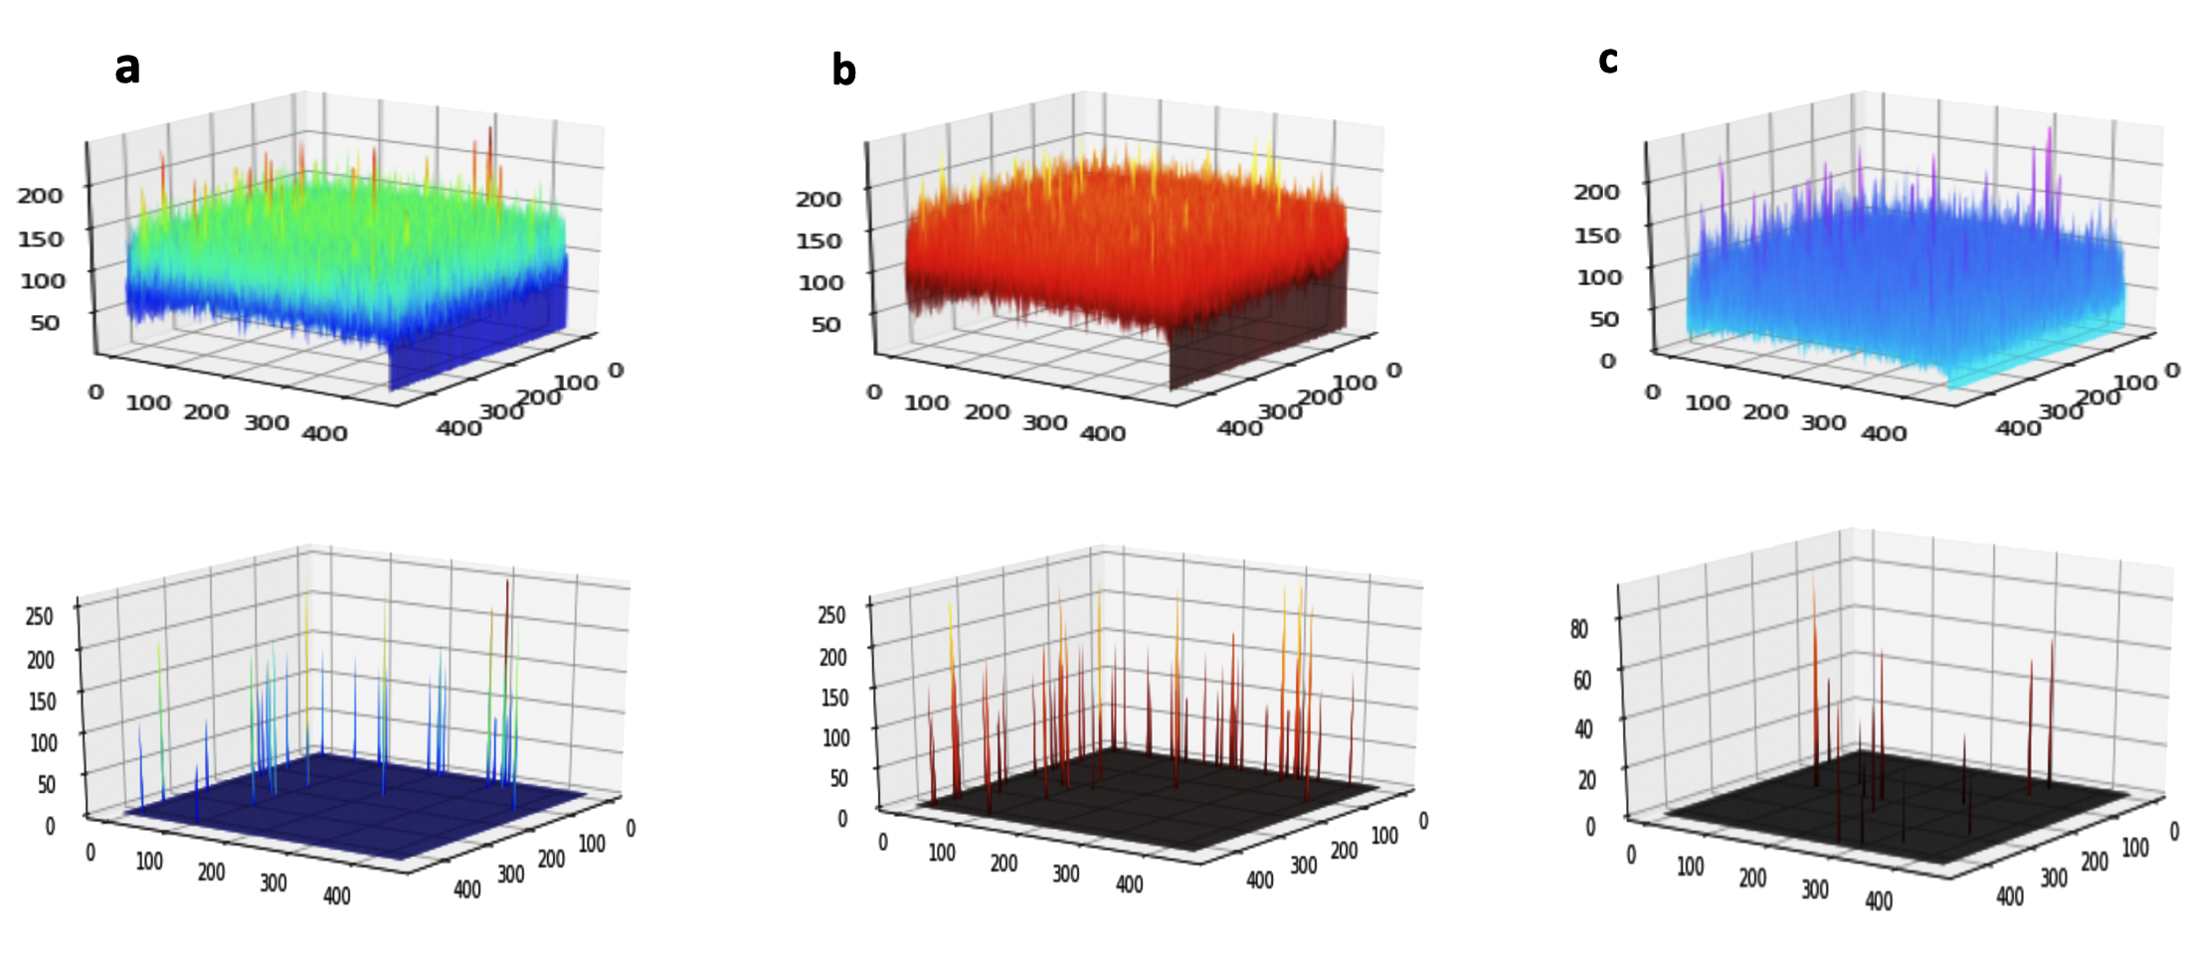
Applying the filters and thresholdings

Slide 10
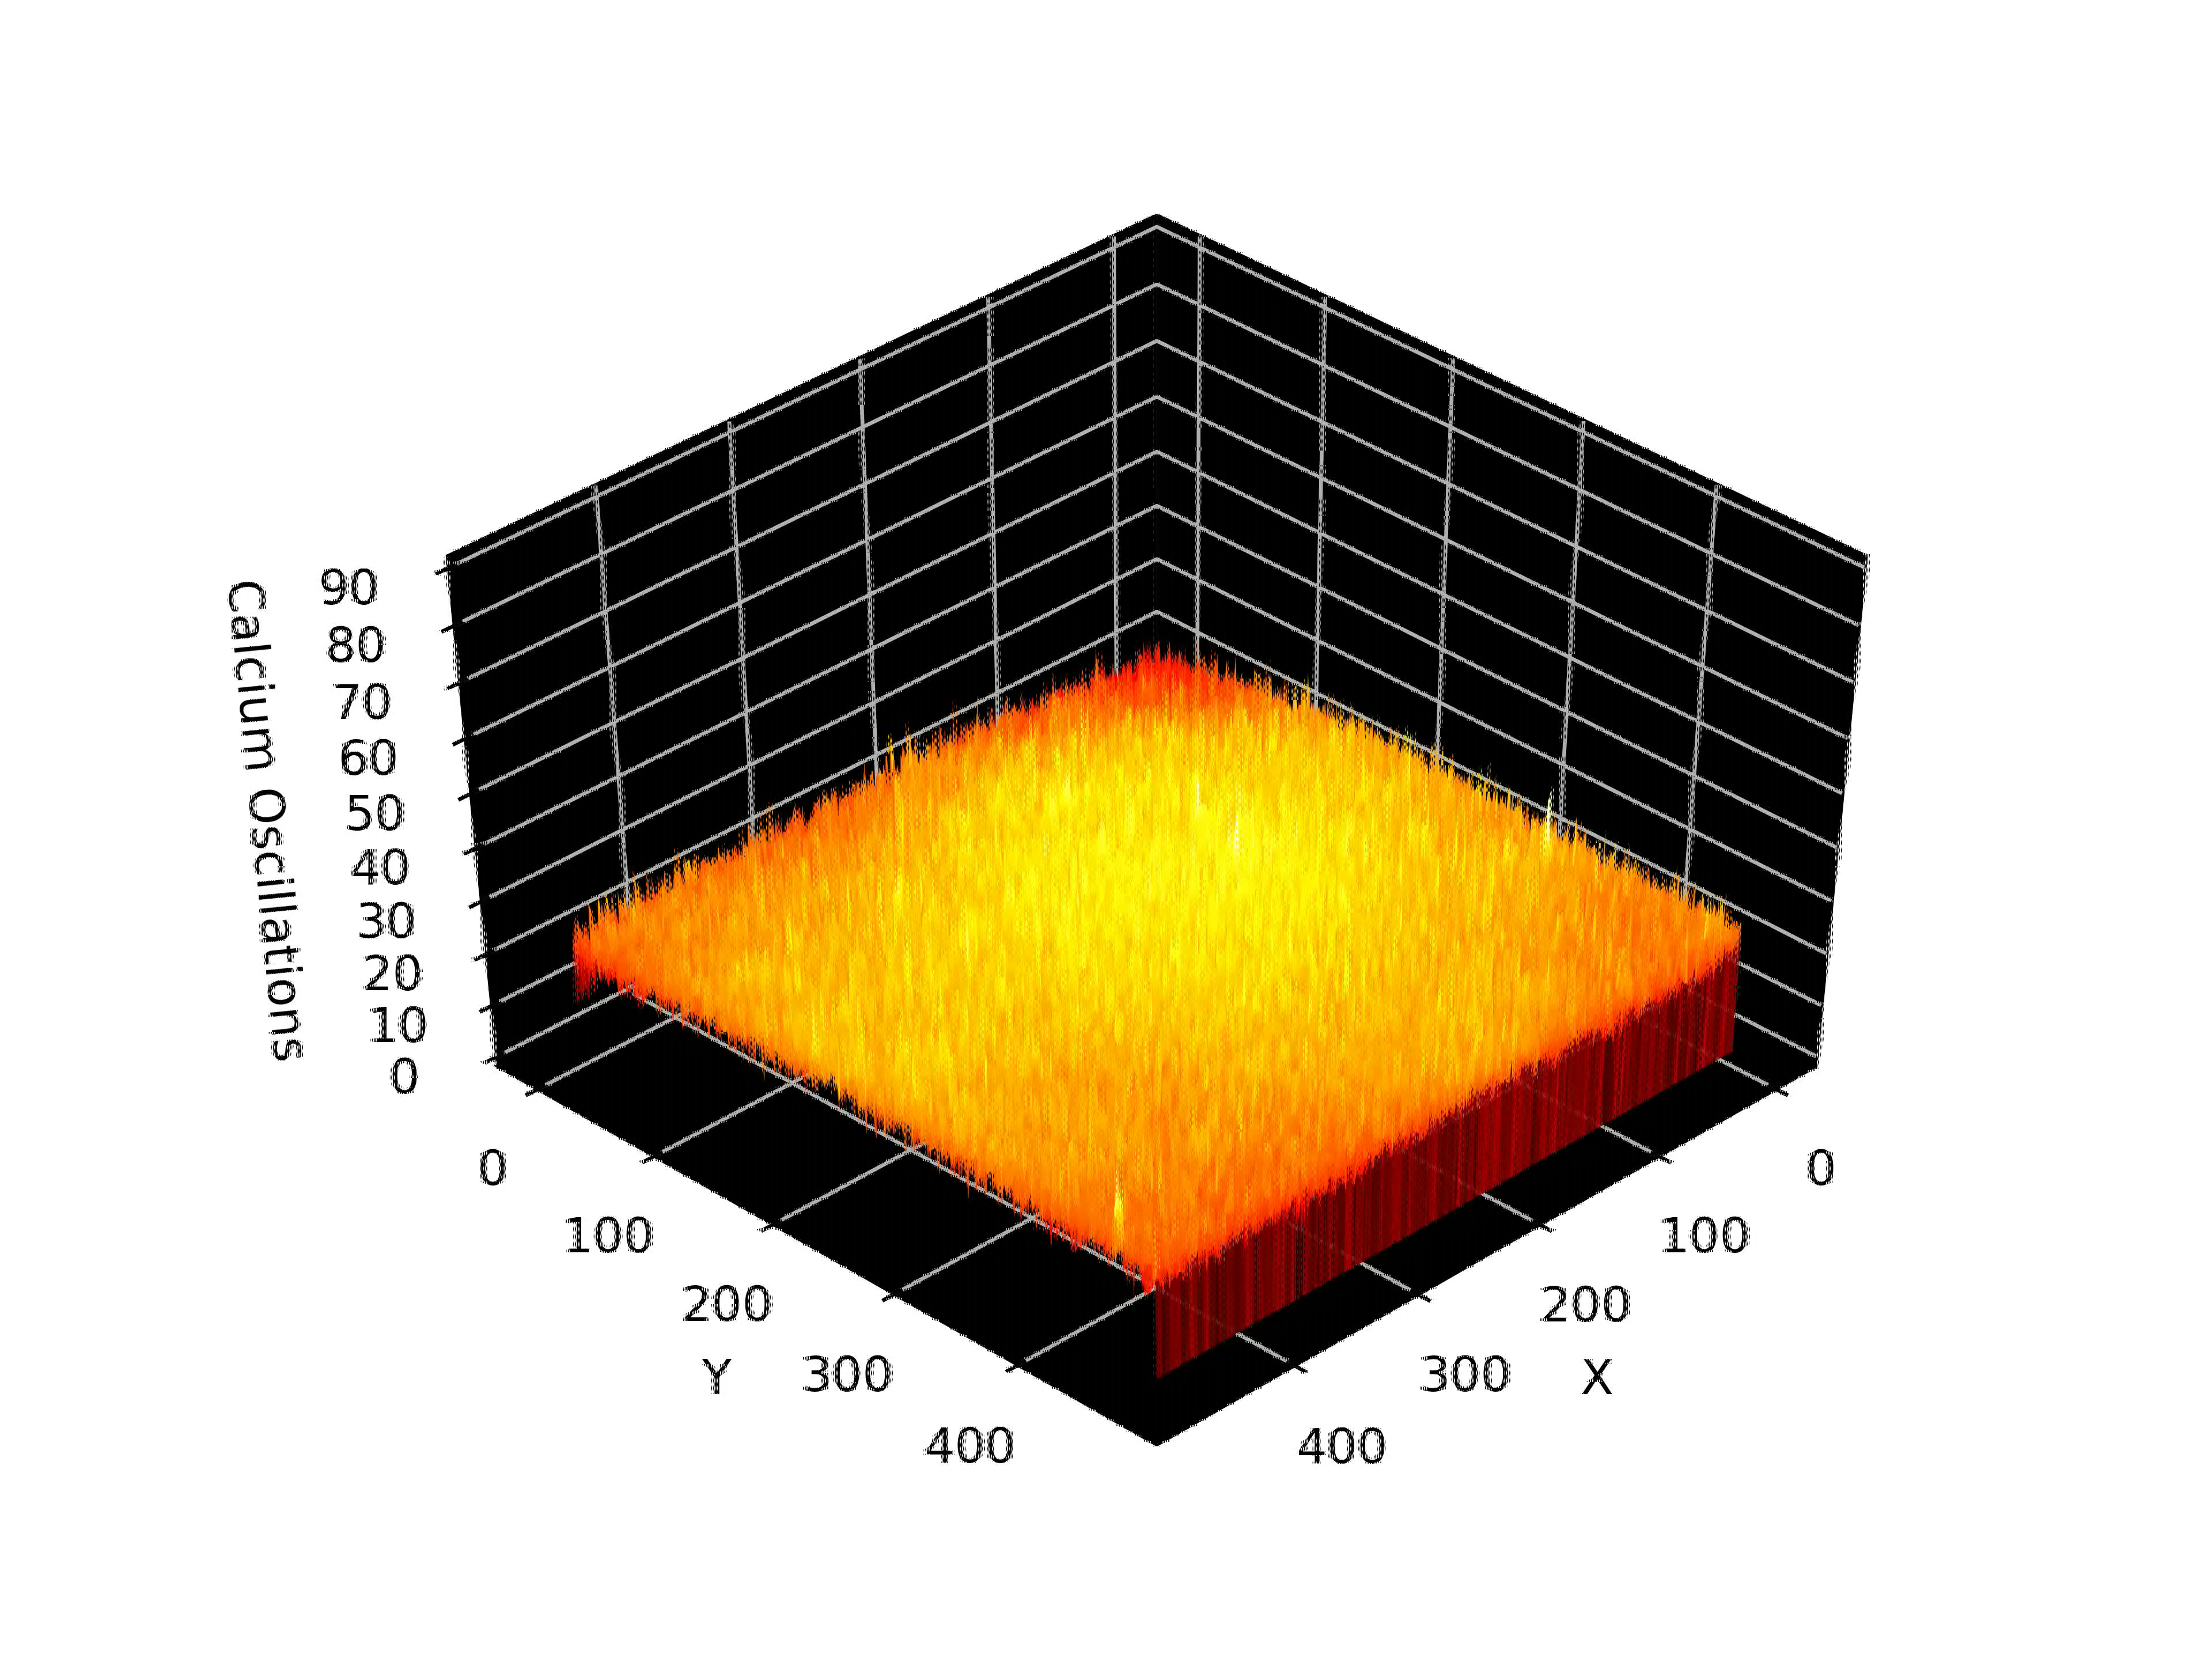
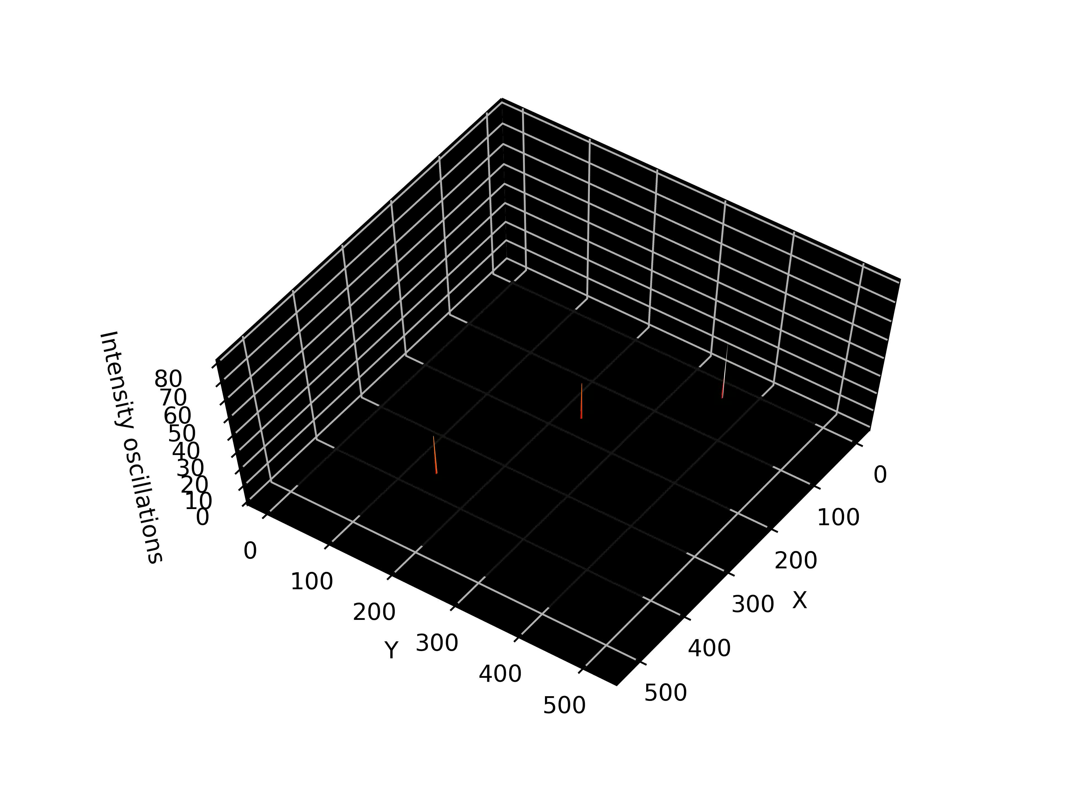
Thresholding and Sparsification
Intensity Oscillation

Slide 11
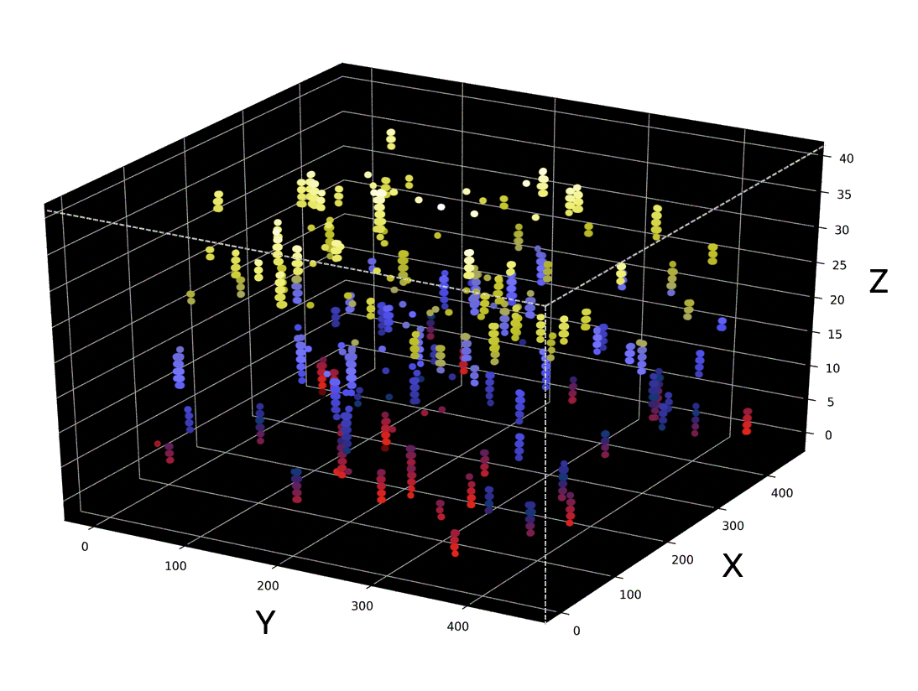
Unifying the Cell particles
First: Representation of the potential locations of the particles: by finding the locations of the intensity spikes and visualizing them in 3D space, we are trying to have an understanding about the locations of the cells.

Slide 12
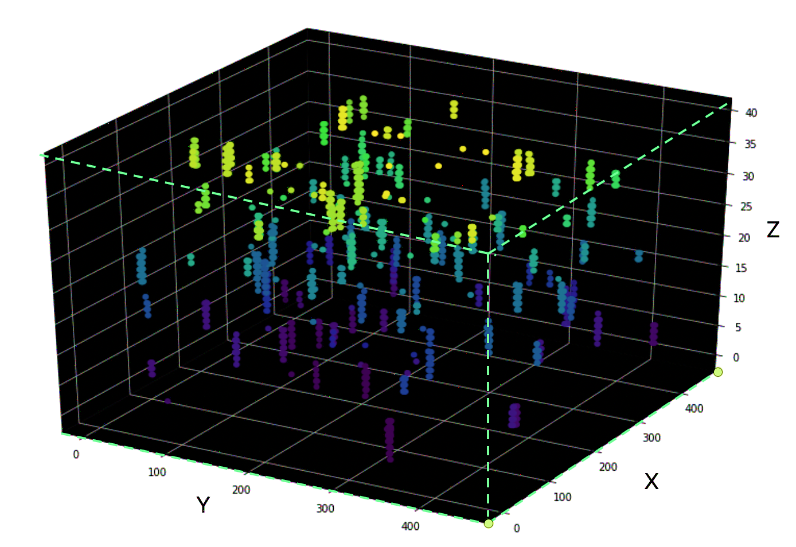
Applying 3D connected components labeling!
Unifying the Cell particles
For tracking we need to have all cell’s point integrated as a single component.

Slide 13
First Comparison with the ground truth
ground truth
Our result
After creating the components we overlayed all 63 frames to check the results with the ground truth!

Slide 14
Let’s check again the ground truth with center of masses
ground truth
Our result
OK! Now we are more closer to the ground truth ! Just we need to remove the false positives !

Slide 15
6th step: Removing the noises
By computing the volume of each component and filtering out the small components removed the false positives !
ground truth
Our result

Slide 16
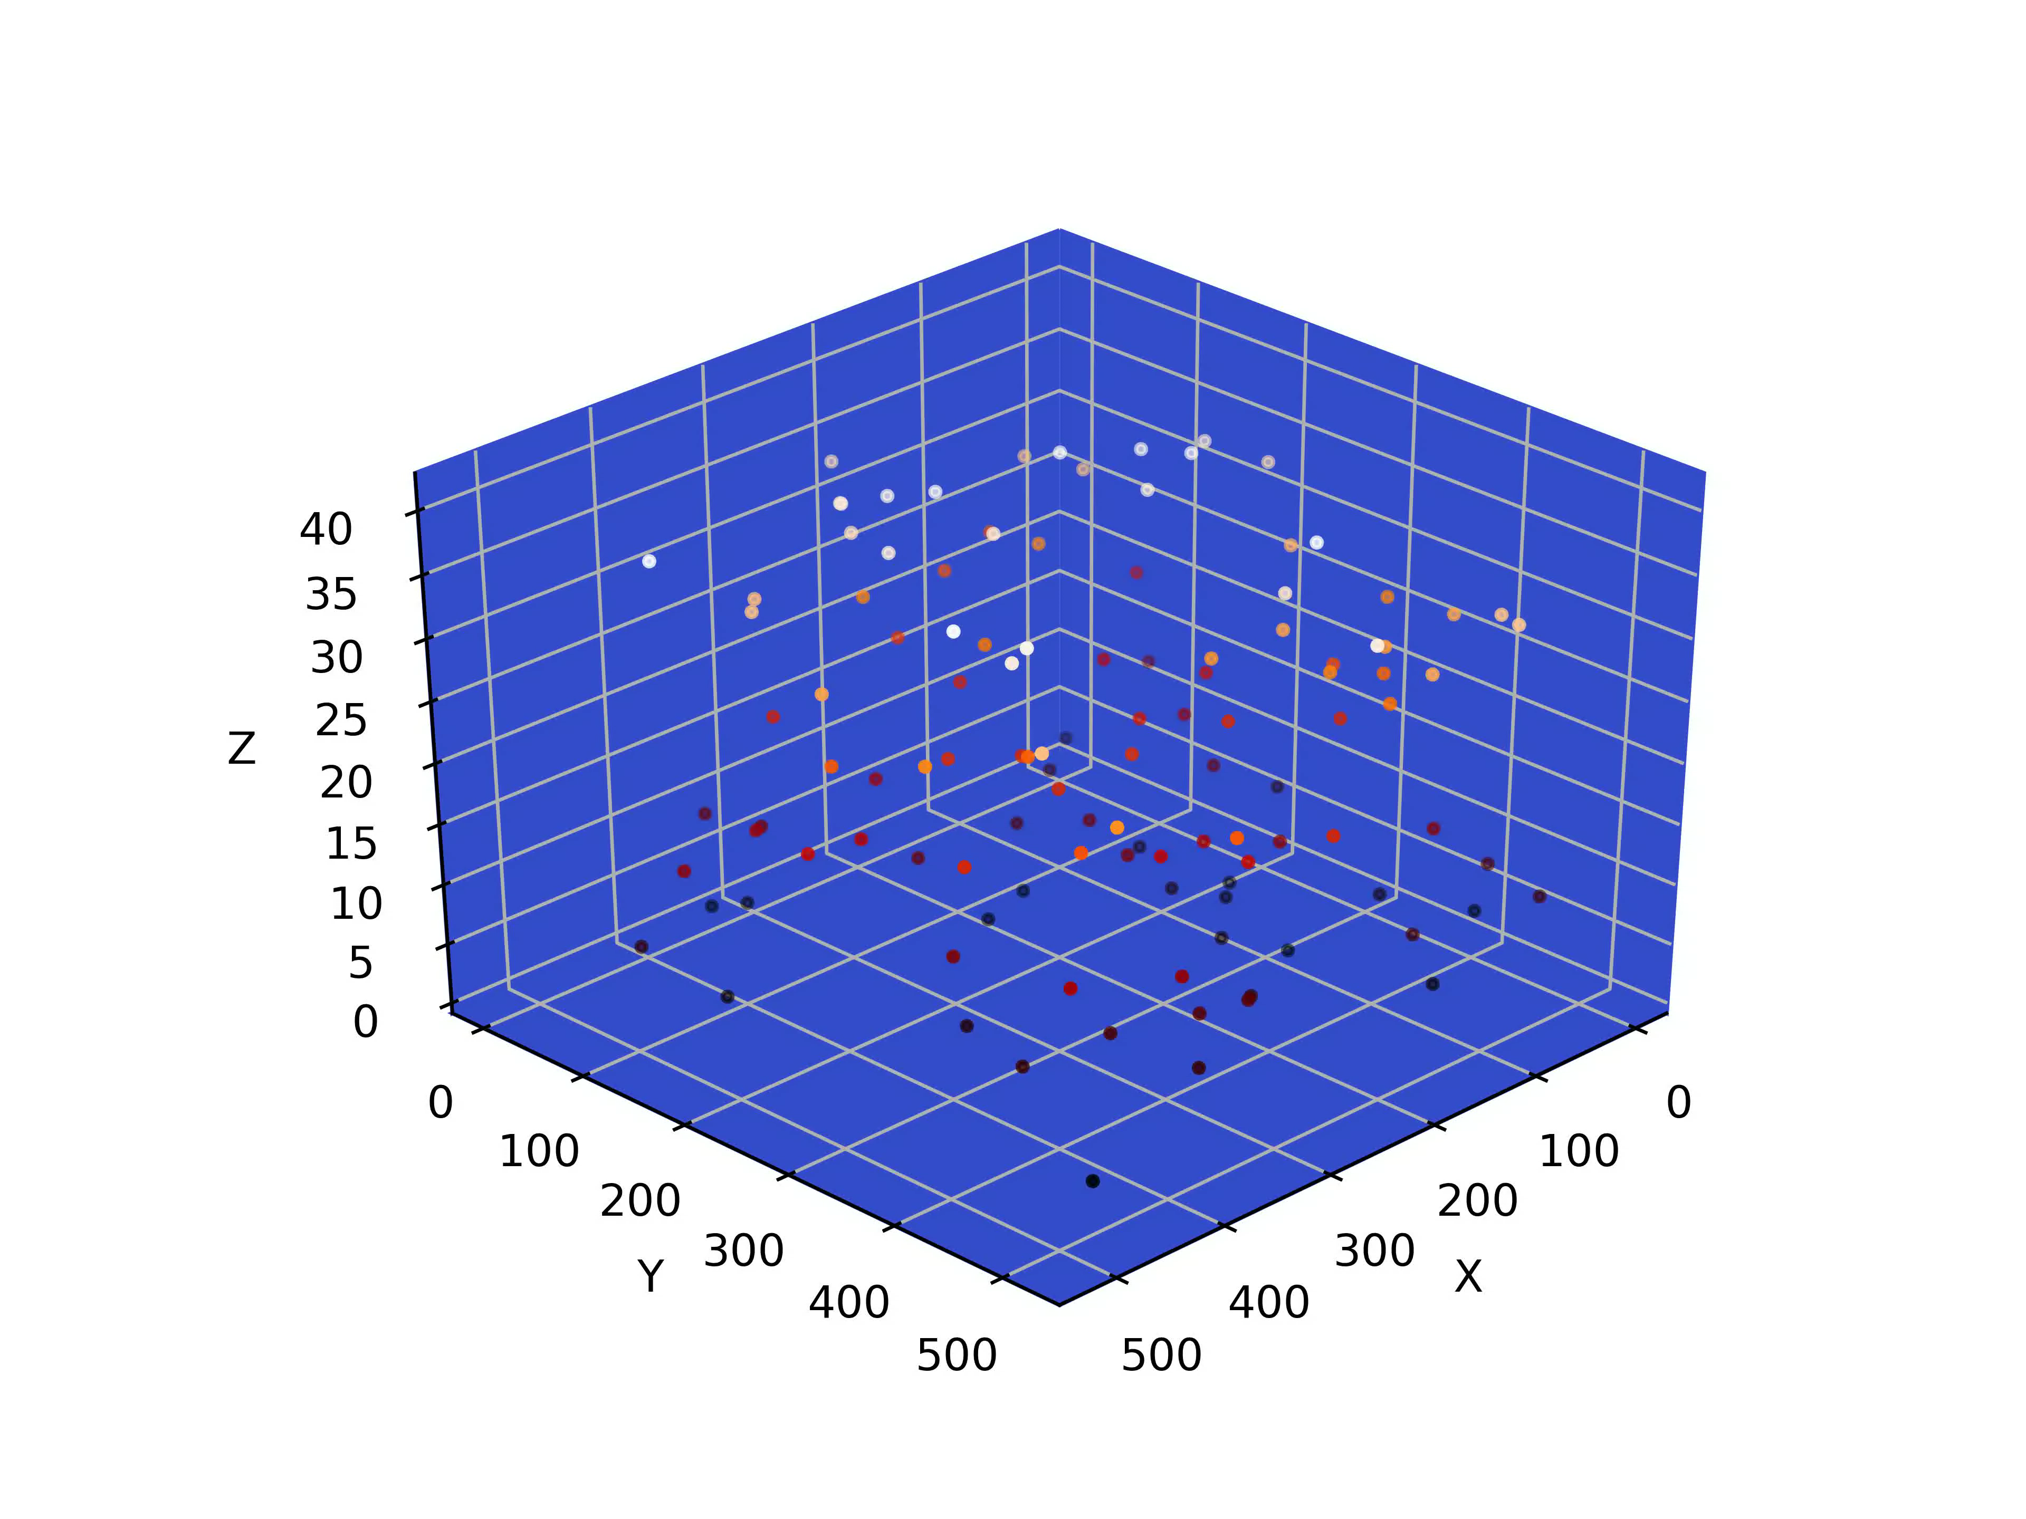
Let’s see how the objects are moving across the time !

Slide 17
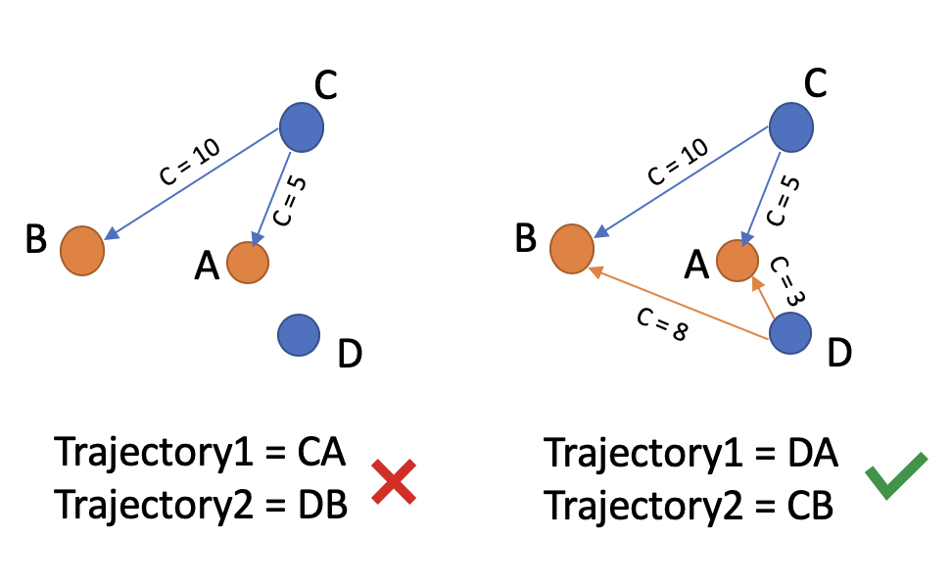
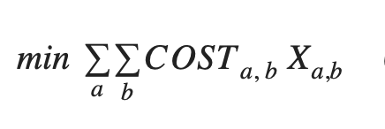
Tracking the Cells :
After extracting all the centroids of the masses, we have a jagged list of the centers.
We used Hungarian Algorithm for tracking the cells :
The problem of local assignment :
we need to set a distance threshold on the distance between two points not exceeding the defined value in two consecutive frames.

Slide 18
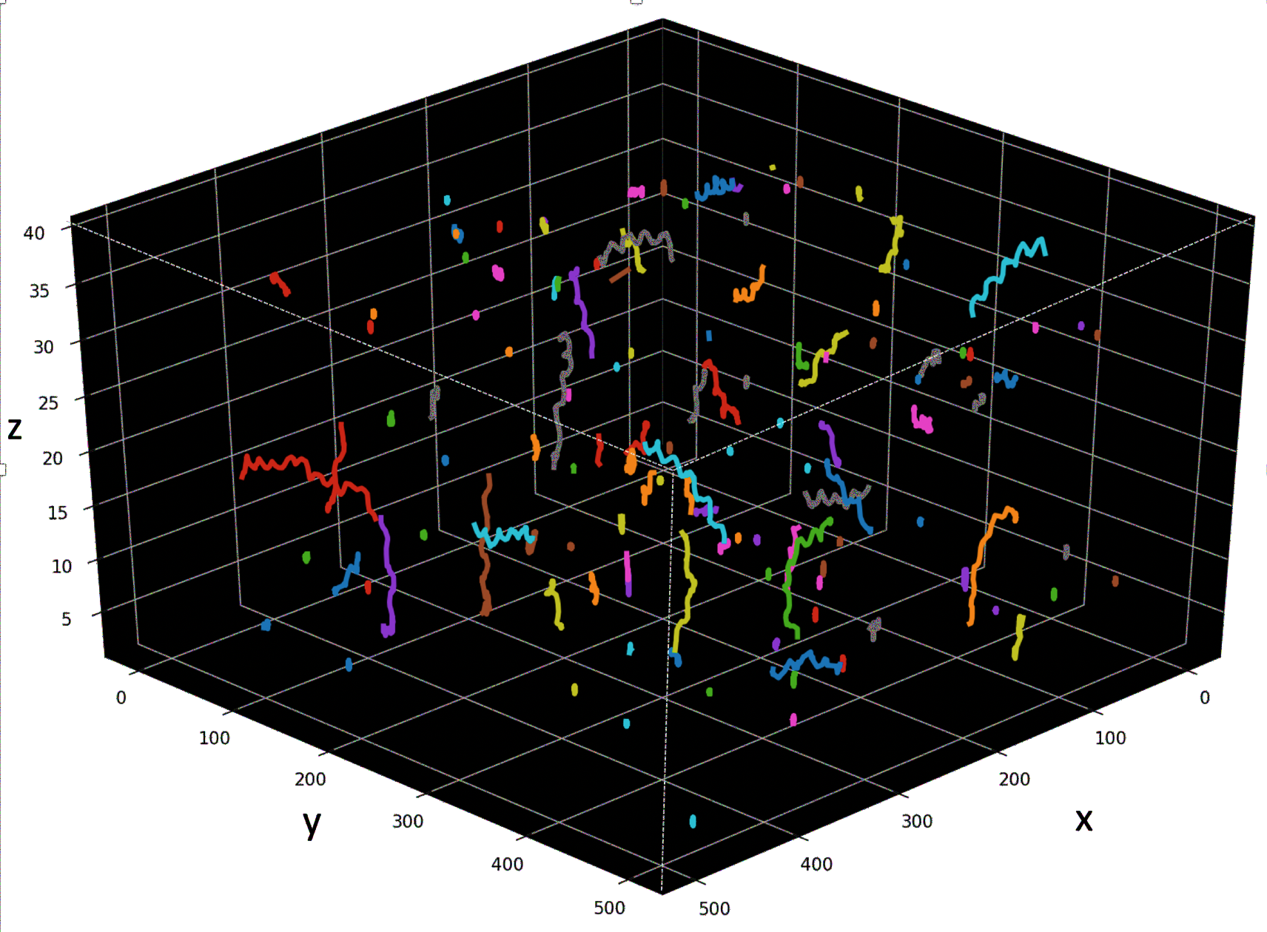
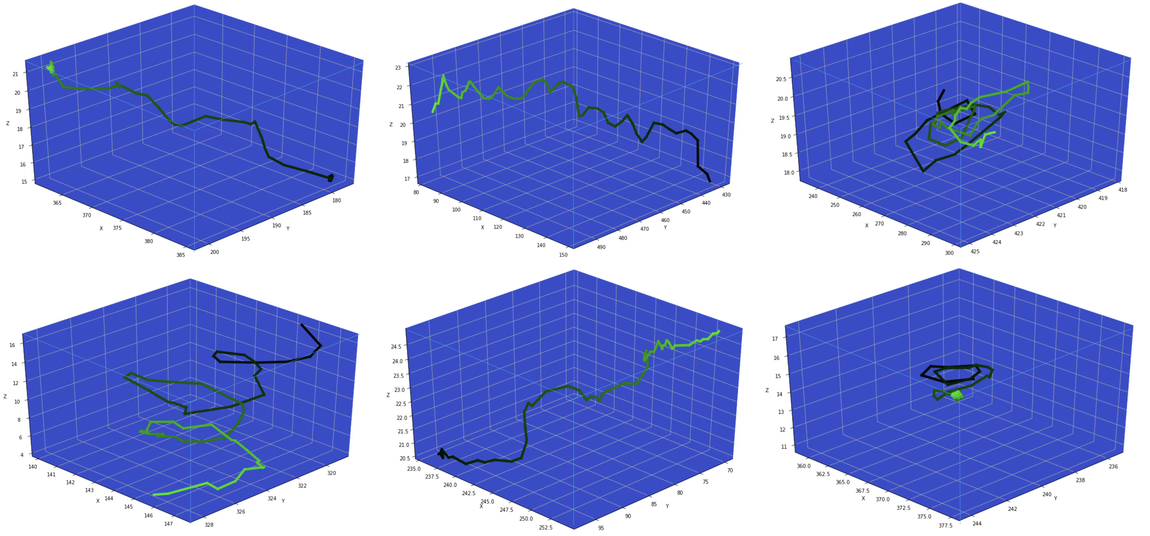
Tracking Results :
Aggregated result of the tracked cells trajectories in a single plot
4D Representation of spatiotemporal dimensions of the tracked cells across a video

Slide 19
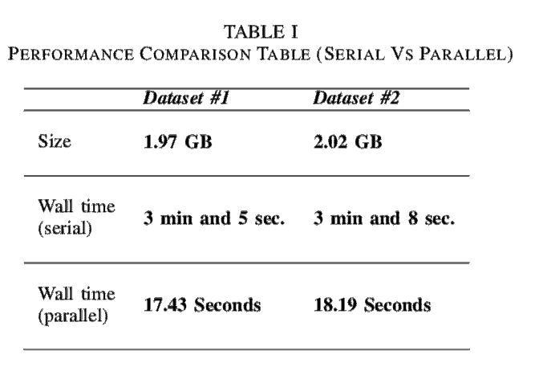
Framework Parallelization:
First we identified the bottlenecks :
Preprocessing module
Thresholding part in Sparsification module
3D connected component part in Detection module
Computing the center of the mass in Detection module.
Computing the mass volumes and filtering out the false positives in Detection module

Slide 20
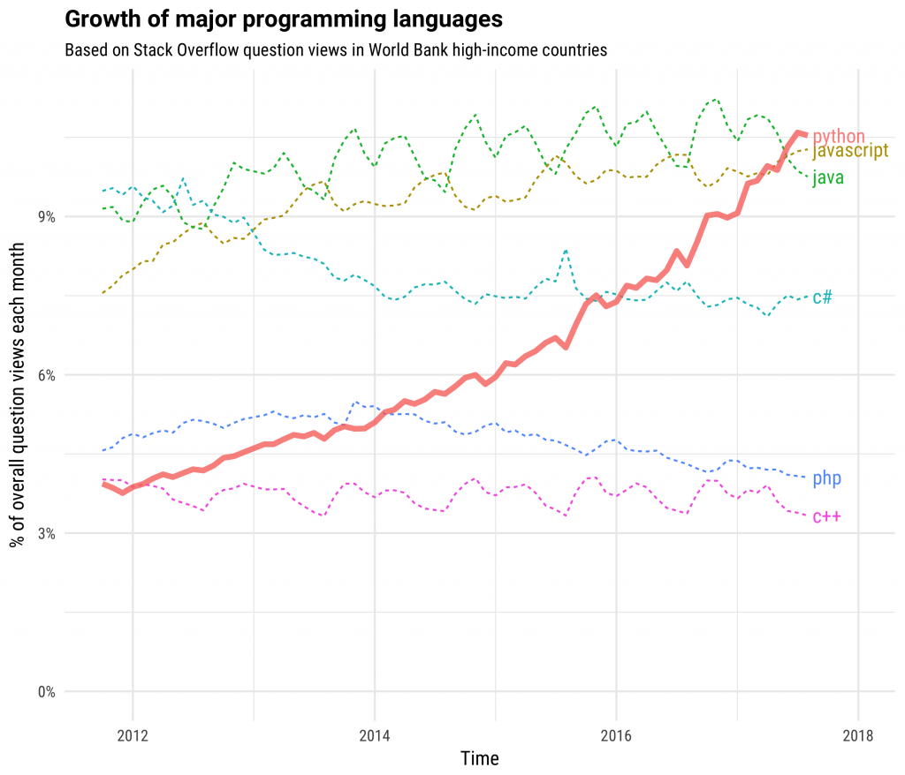
The Dask Version …
What is Dask?
Why Dask?
- The Python’s role in Data Science
- computational libraries like Numpy, Pandas, and Scikit-Learn and by a wealth of libraries for visualization, interactive notebooks, collaboration, and so forth.
- Writing the code once and then choose to either run it locally or deploy to a multi-node cluster using a just normal Pythonic syntax.

Slide 21
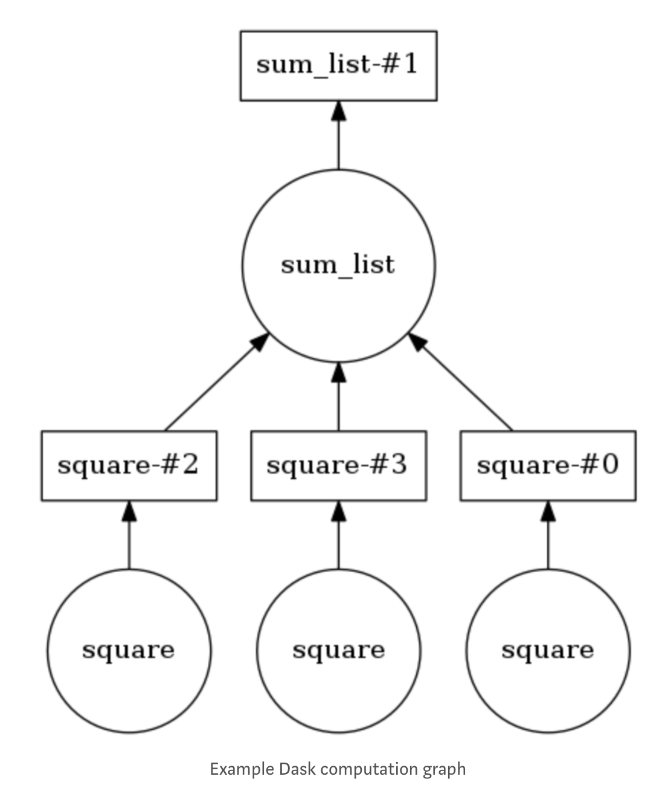
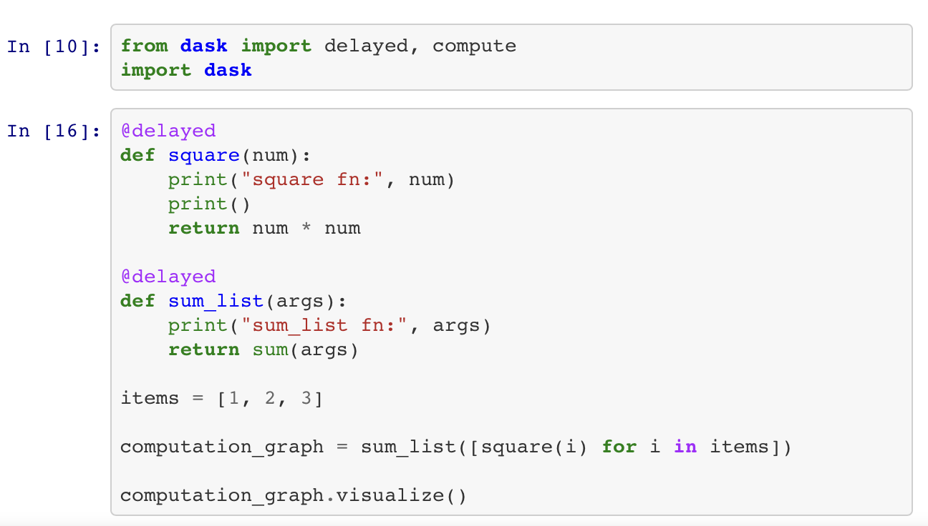
The Dask Version …
Dask introduces 3 parallel collections that are able to store data that is larger than RAM, namely Dataframes, Bags and Arrays.
Each of these collection types are able to use data partitioned between RAM and a hard disk as well distributed across multiple nodes in a cluster.
Example :

Slide 22
The Dask Version …
Z
Y
X
Frame 0
Frame n

Slide 23
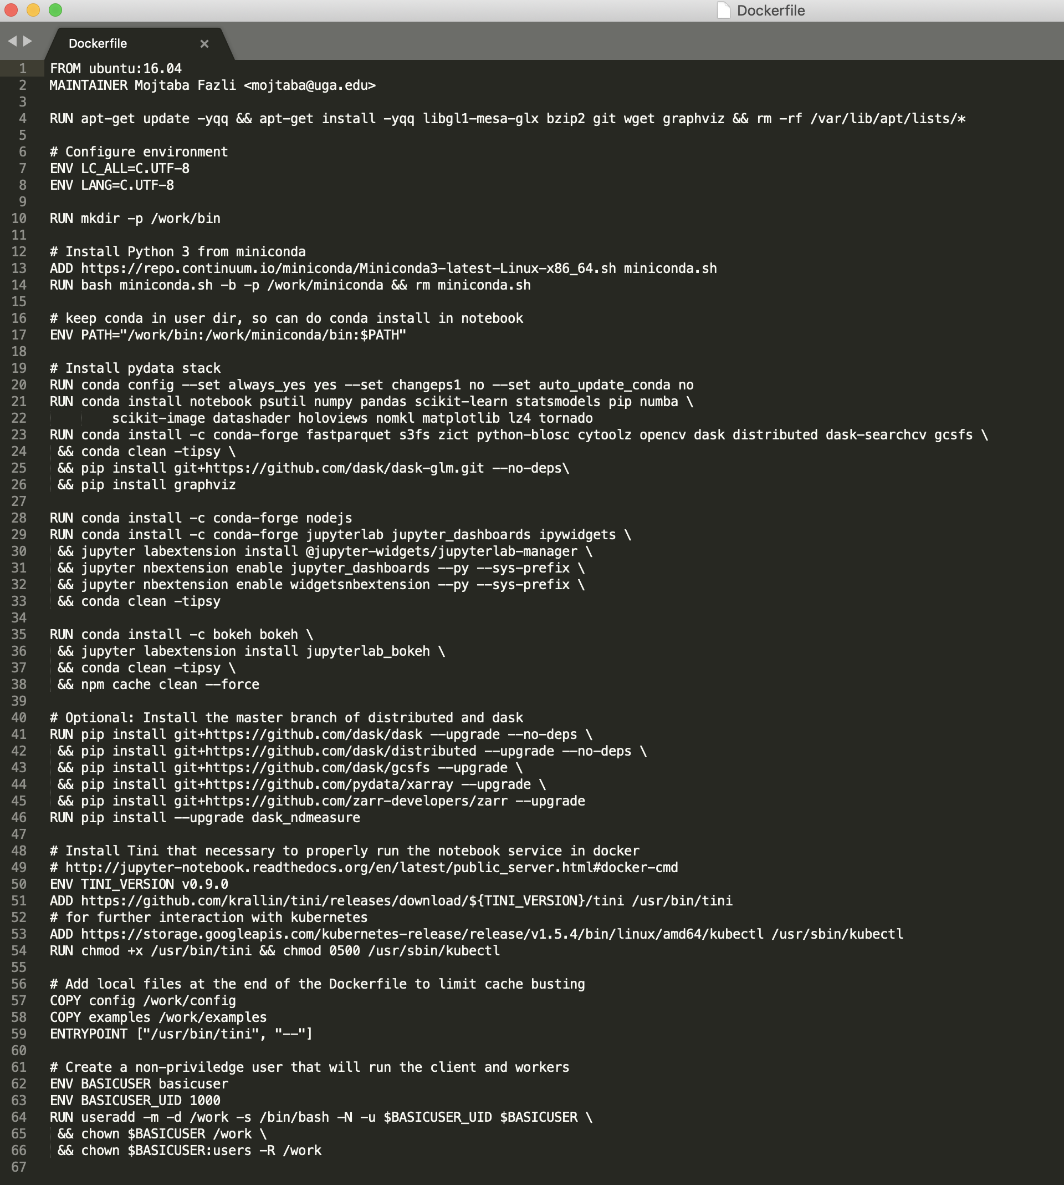
How to Run Dask on GCP
1. Creating a Docker file for setting all the dependencies and the libraries

Slide 24
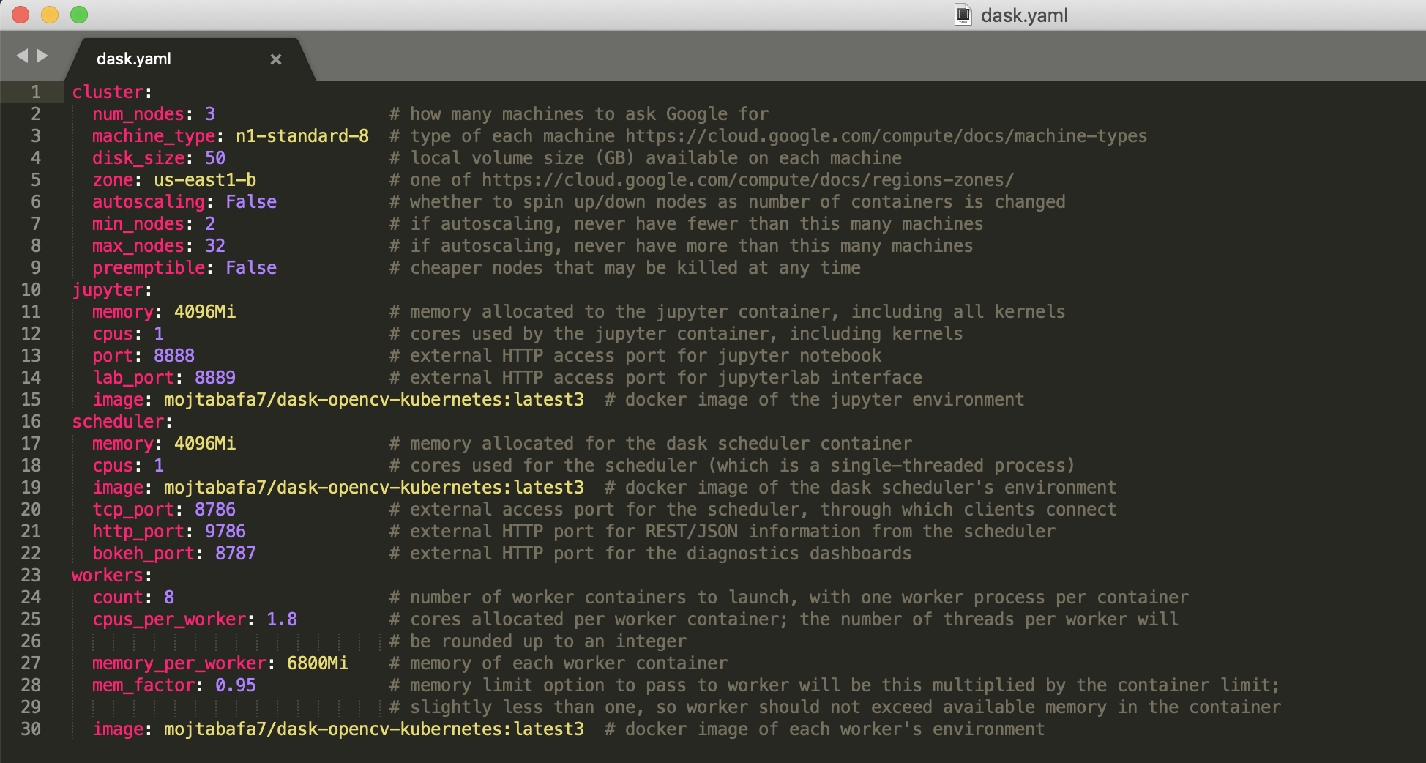
How to Run Dask on GCP
2. Creating a “YML” File for setting all details of the cluster. In “YML” file the address of the Docker image for “ Jupyter, Scheduler and workers” should be defined. That address will be in “DockerHub”

Slide 25
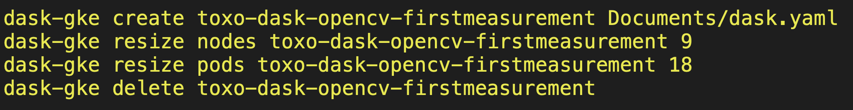
How to Run Dask on GCP
3. Using GCP dask terminal (dask-gke) we will connect to GCP
There we can create, resize or delete the clusters on GCP.

Slide 26
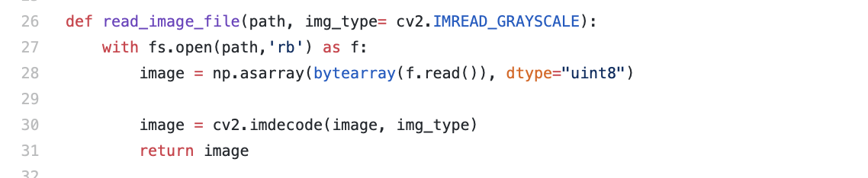
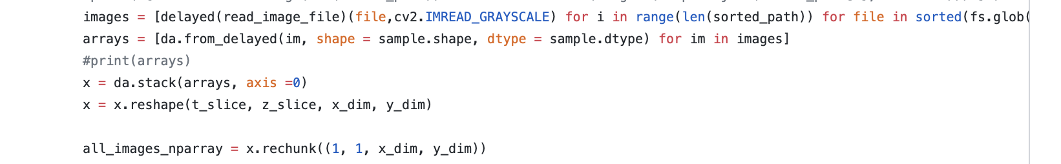
The Dask Version …
Bottlenecks:
1 – Reading the data from the Bucket
2- Computing the 3D CCL
3- Computing the Center of Mass

Slide 27
The Dask Version …
 | Data Set 1
Size of the data set | 2.02 GB
Dask vesrion Wall time ( single Machine / 4 cores / 16 GB RAM/ Core i3 ) | 59.43 Sec
Dask vesrion Wall time ( single Machine / 32 cores / 128 GB RAM/ Core i9 ) | 18.74 Sec
Dask vesrion Wall time ( 3 workers / 8 pods ) | 78.43 Sec
Dask vesrion Wall time ( 9 workers / 21 pods ) | 31.43 Sec

Slide 28
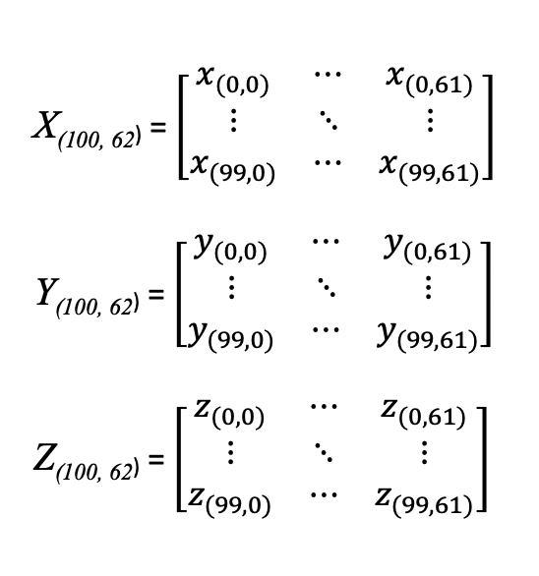
3D Trajectories clustering:
1. Creating a corpus of trajectories :
Discarding any trajectories below a certain minimum number of frames. This happens because of the thresholding.
For each trajectory, we truncated the number of frames to be equivalent across all objects.

Slide 29
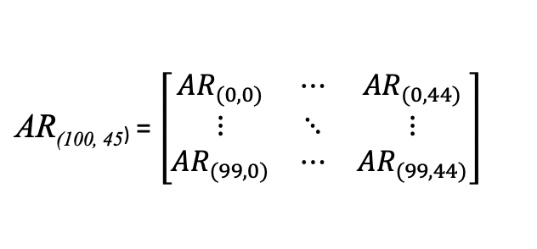
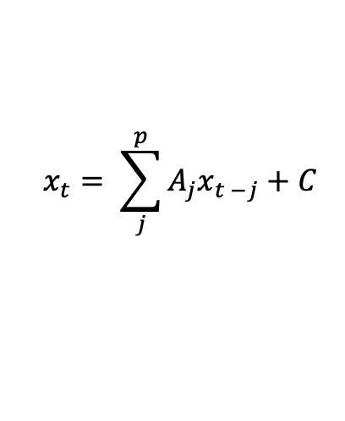
3D Trajectories clustering:
To be invariant to the absolute spatial locations, but sensitive to relative changes over time.
2. Parameterization of Normalized KLT trajectories:
we used a simple linear model that encodes a Markov-based transition prediction method: an autoregressive (AR) model.
we are interested in the transition matrices {A₁, ..., A_{p}},which are quantitative encodings of how the system evolves.
P= 5 5x3x3 AR motion parameters for each trajectory
$$x_{t}= \sum_{j}^{p}{A_{j}x_{t −j}+C}$$

Slide 30
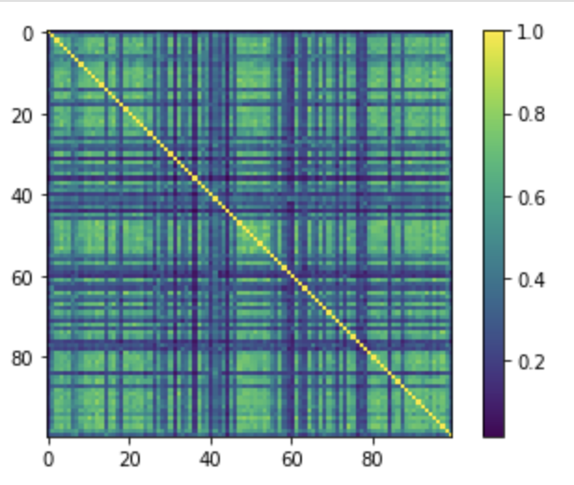
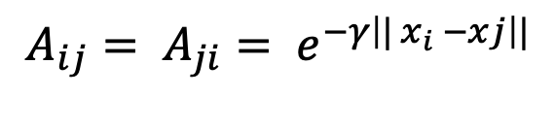
3D Trajectories clustering:
3. Computing pairwise affinities (similarities) :
First, we Used RBF ( Radial Based Function ) for computing the pairwise affinities :
$$A_{ij}= A_{ji}= e^{−γ\left|| x_{i} −xj\right||}$$

Slide 31
3D Trajectories clustering:
4. Applying Spectral clustering:
Pairwise Similarity Matrix
Graph Laplacian
Eigenvectors extraction ( Embedding to low dimensional space)
Kmeans on low-dimensional space ( We considered number of clusters as 3 )

Slide 32
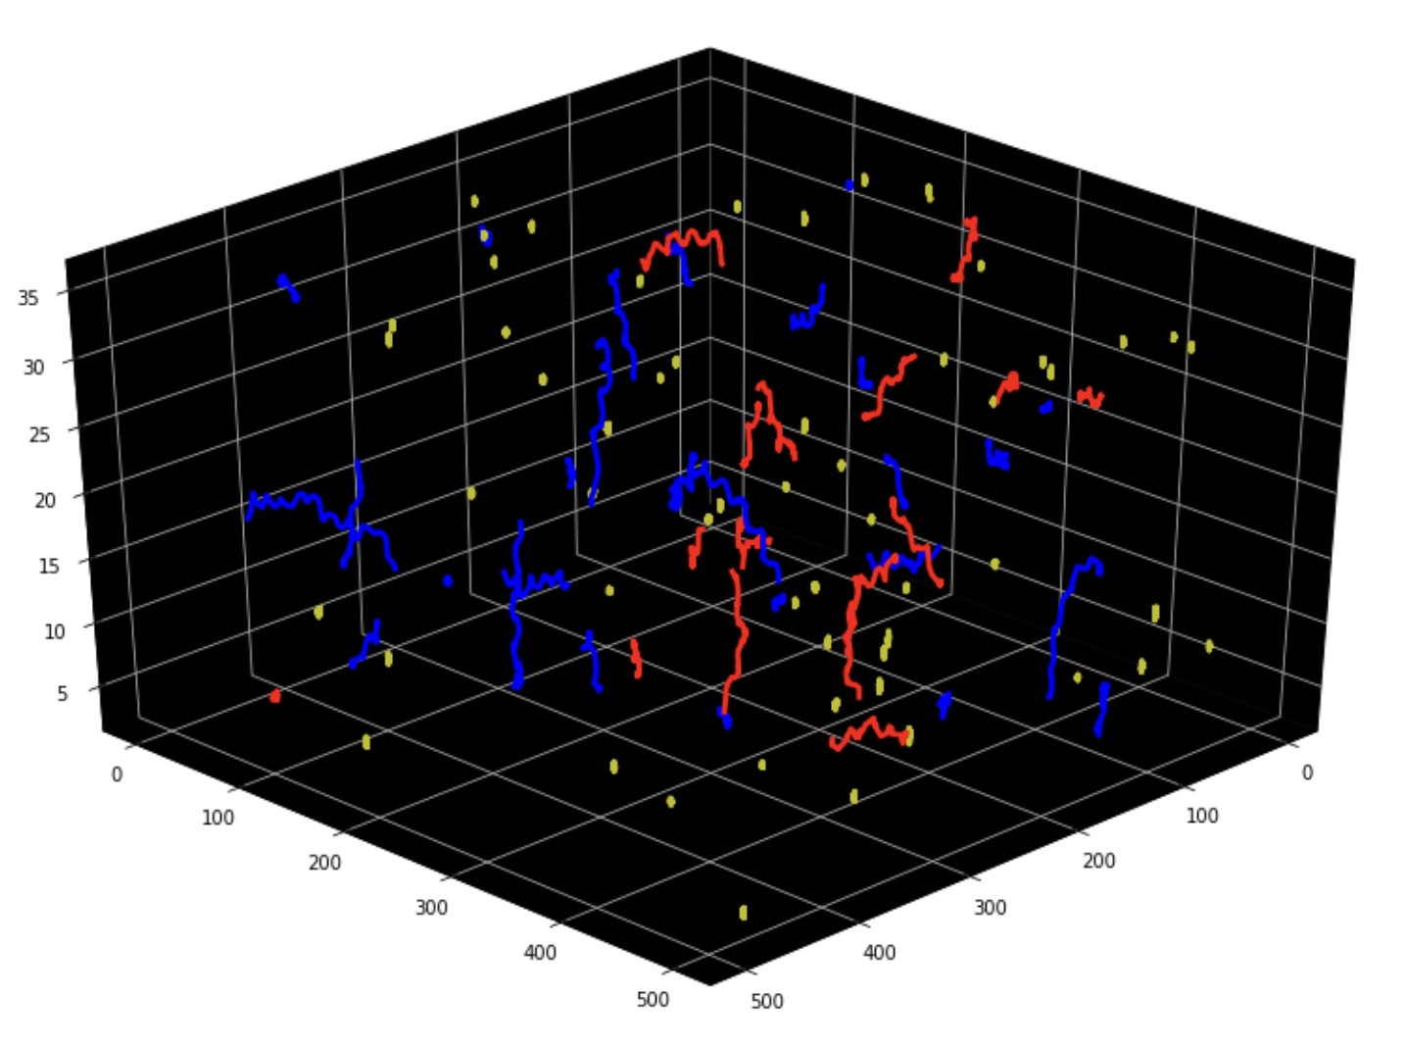
3D Trajectories clustering:
Results

Slide 33
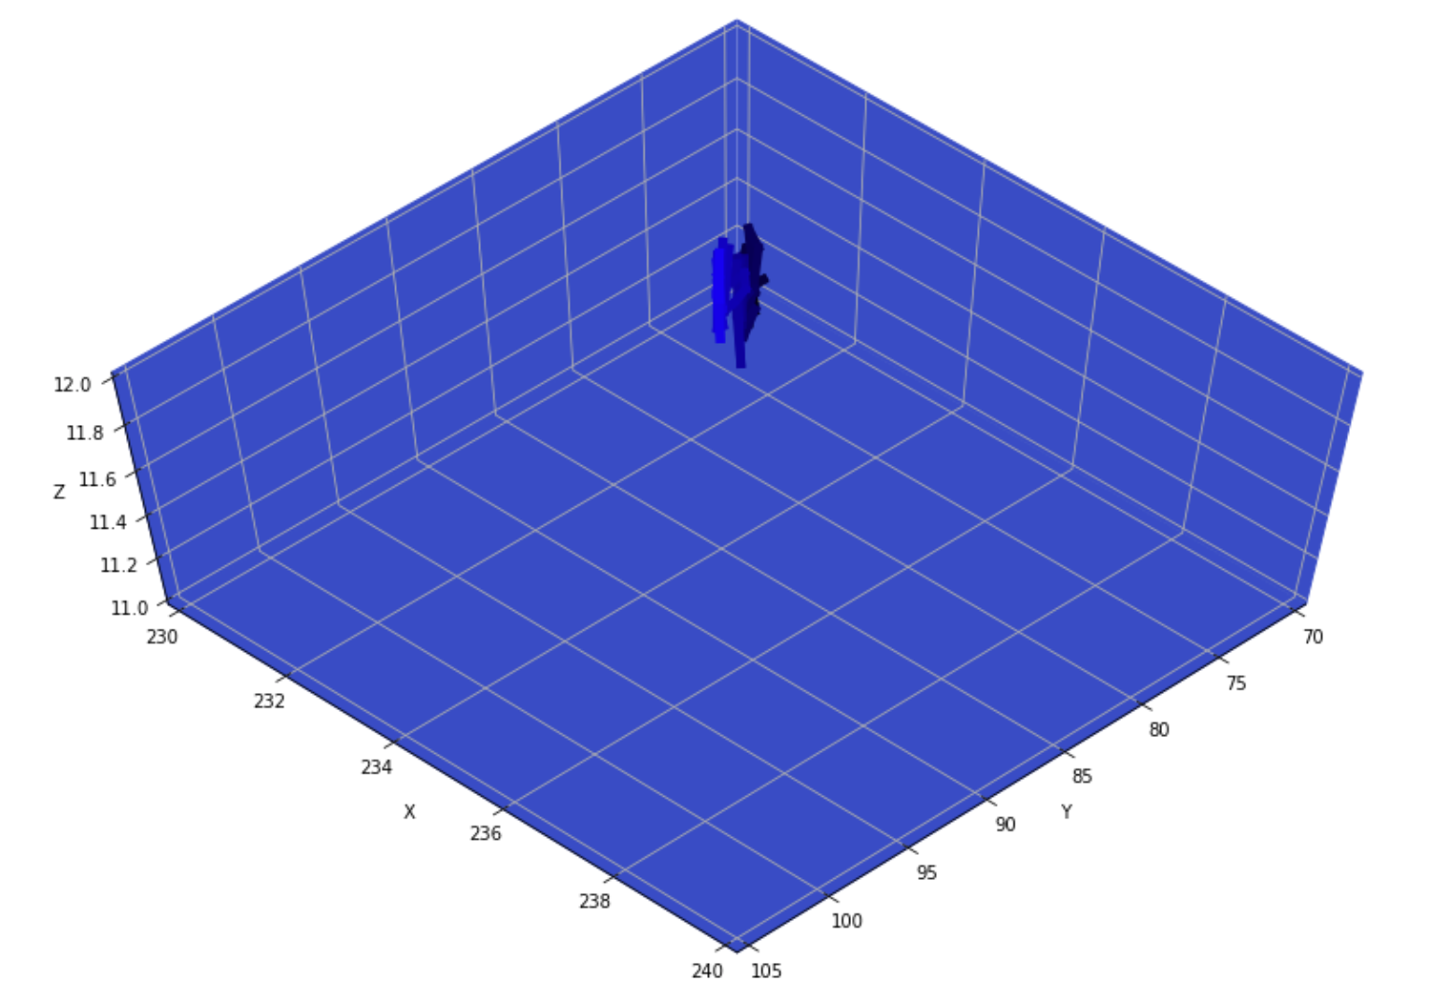
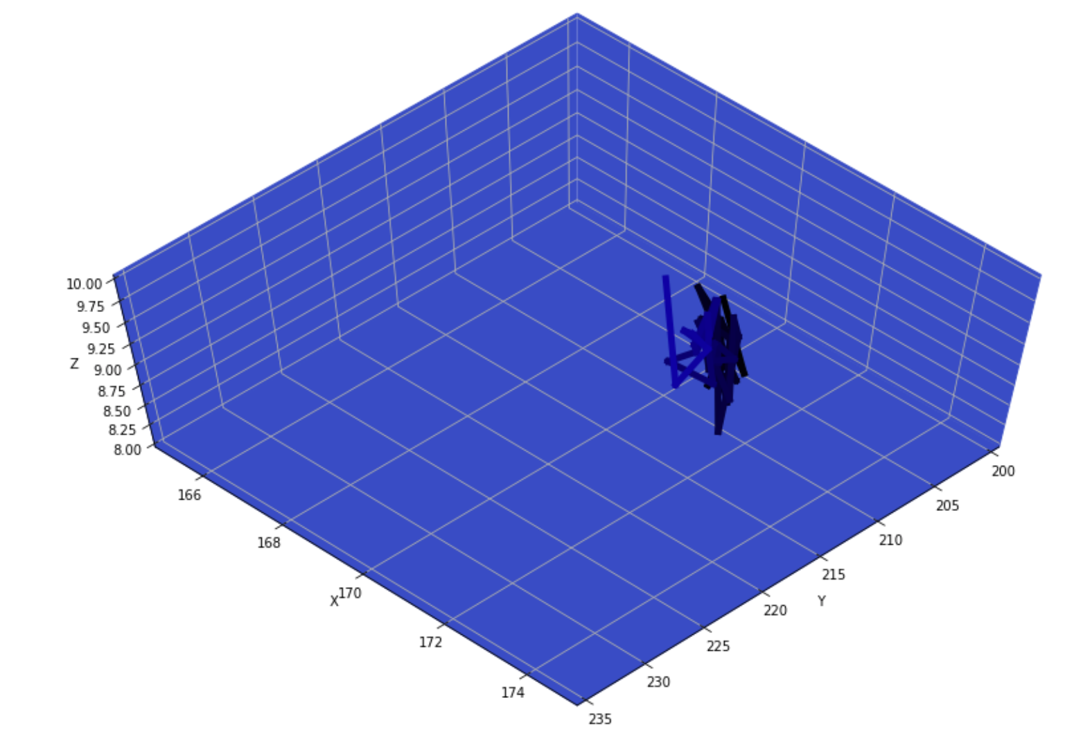
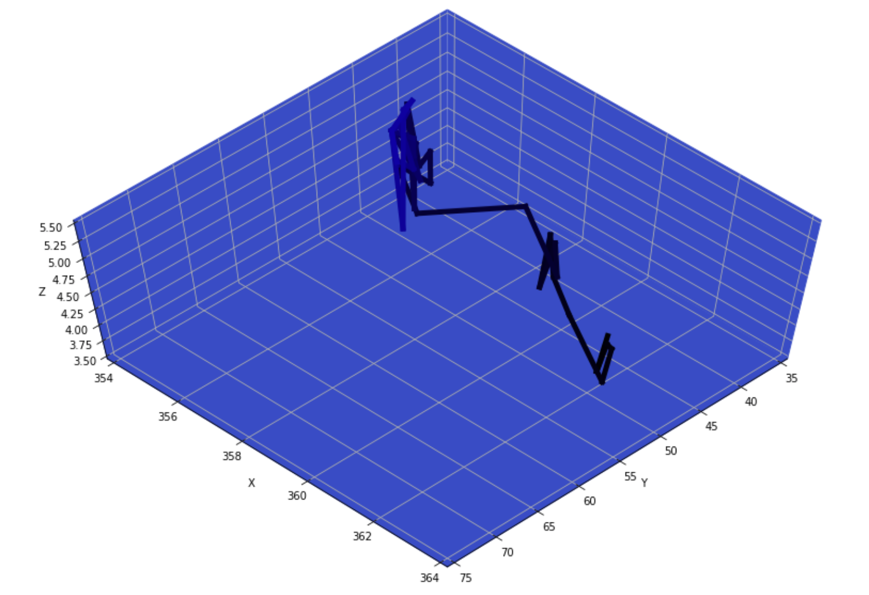
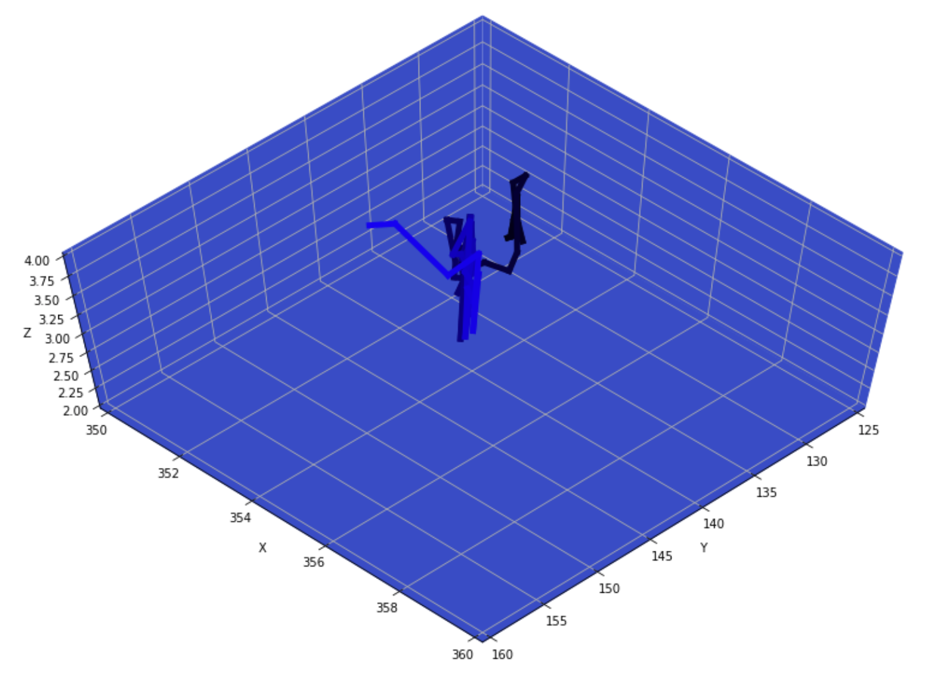
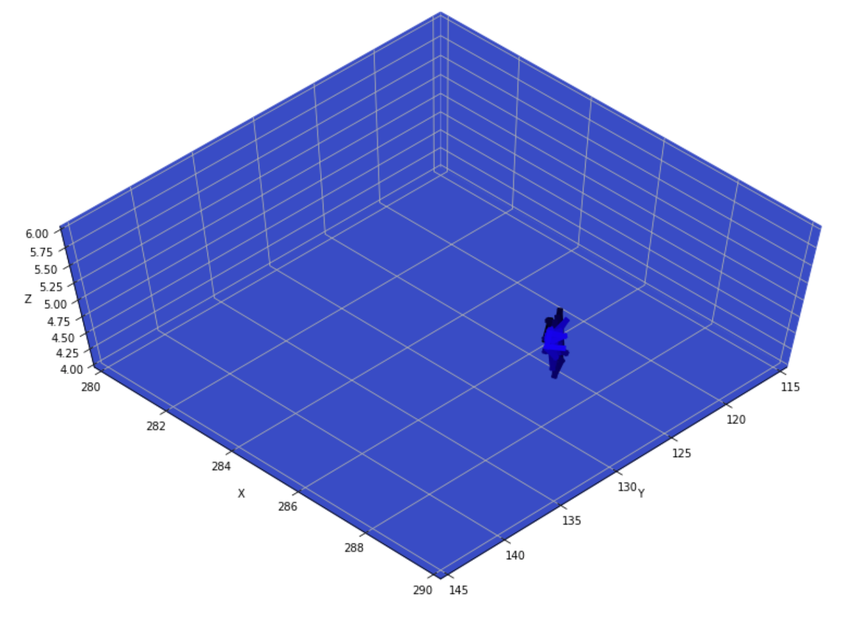
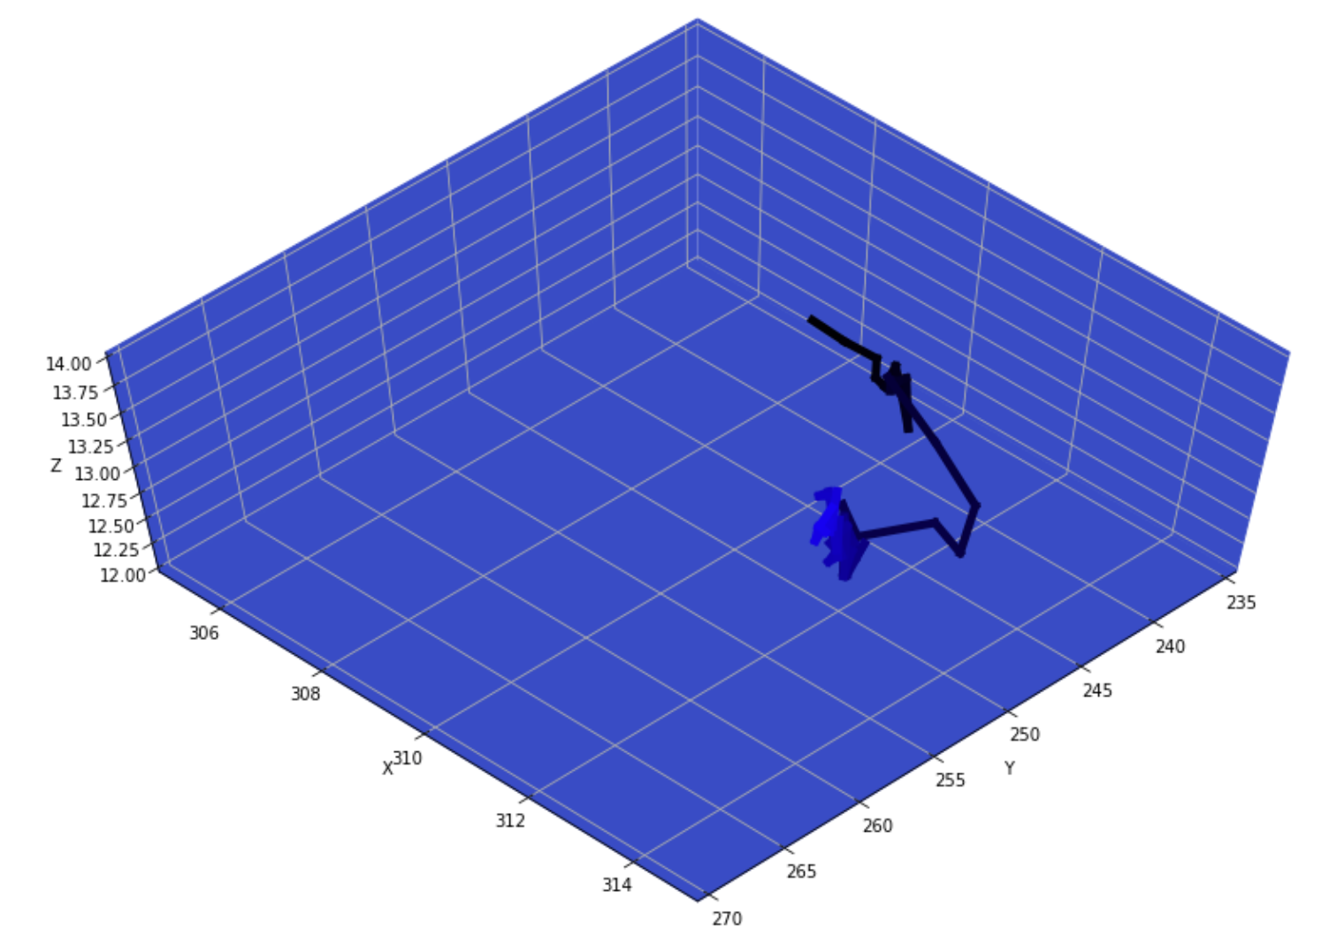
3D Trajectories clustering:
Results

Slide 34
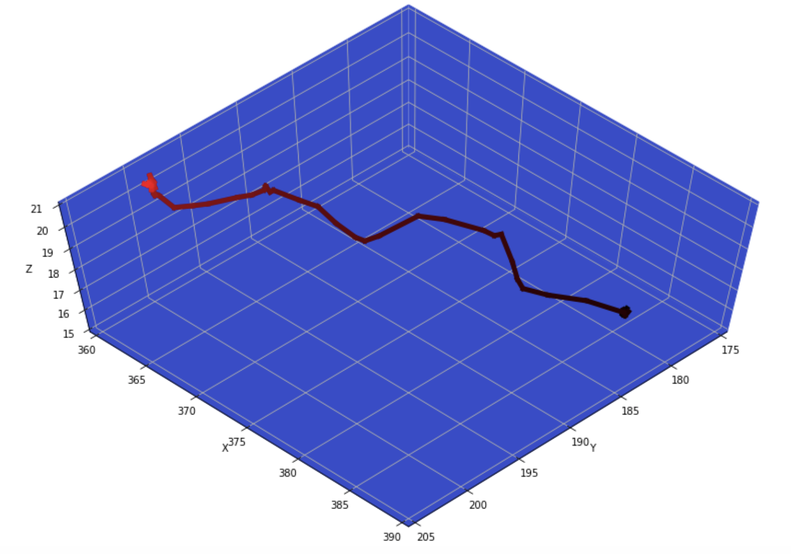
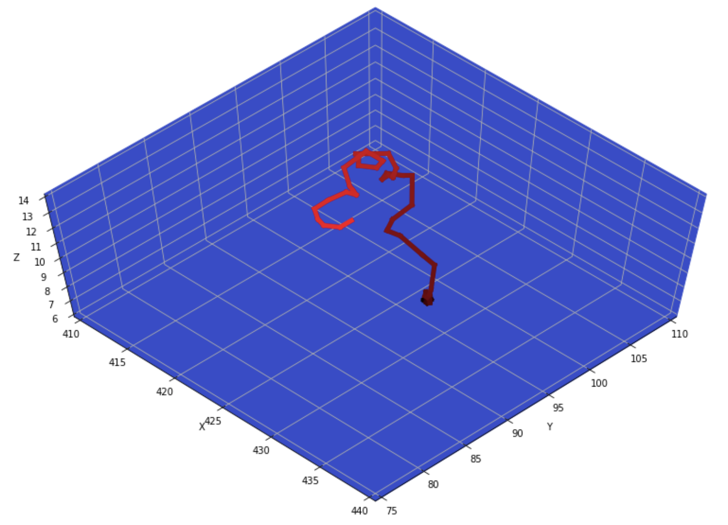
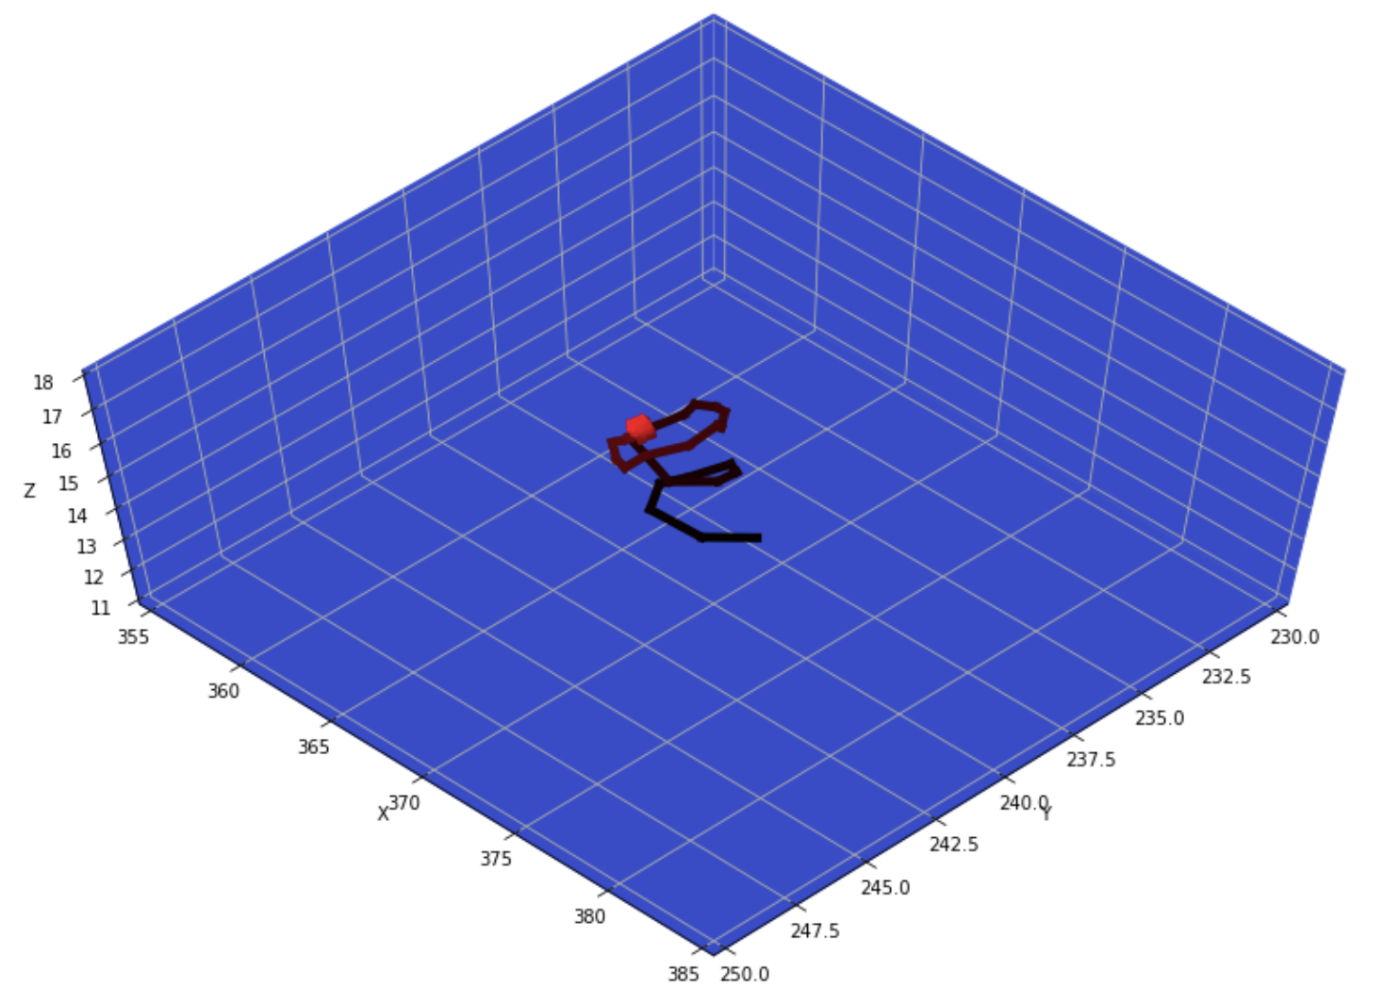
3D Trajectories clustering:
Results

Slide 35
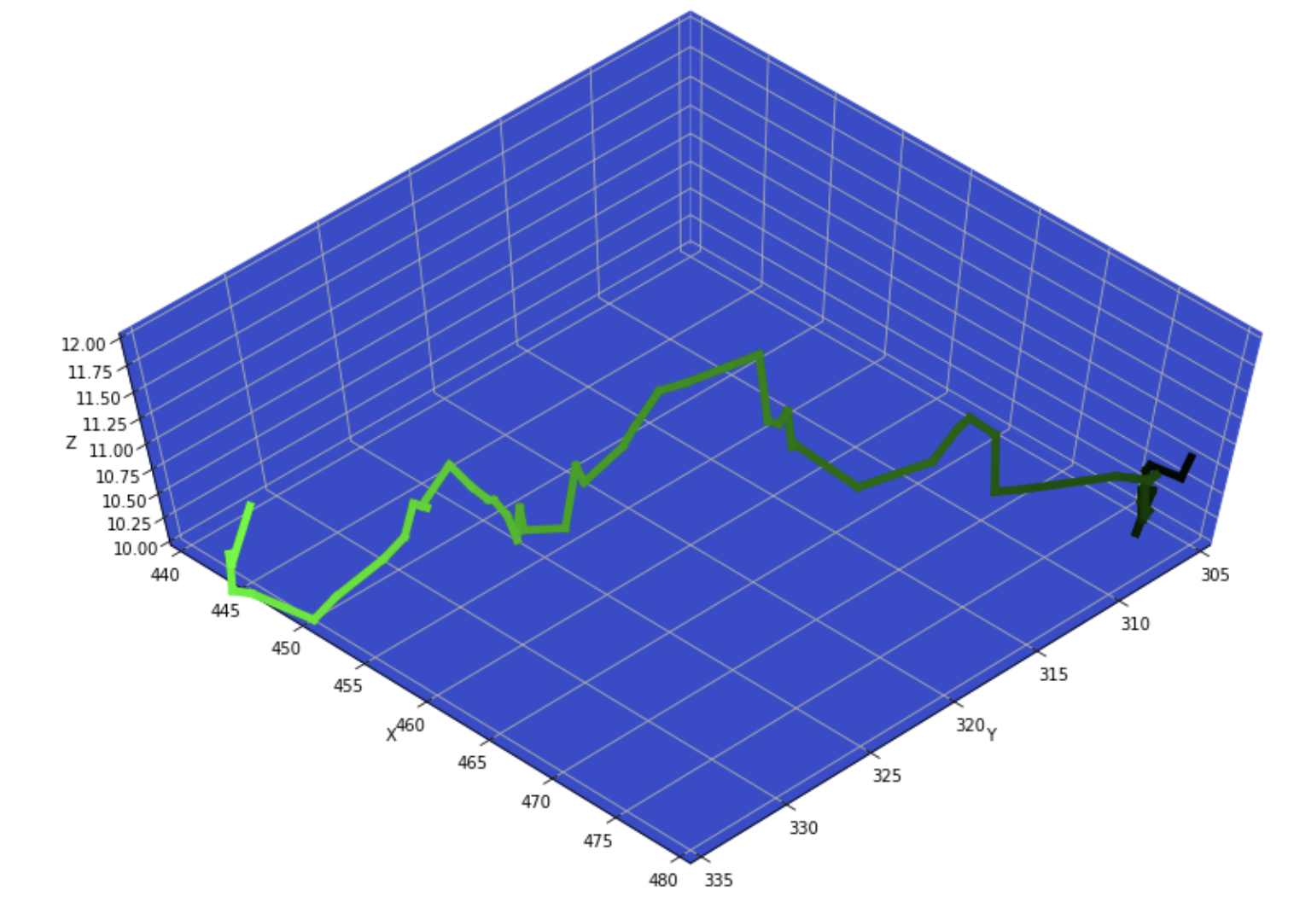
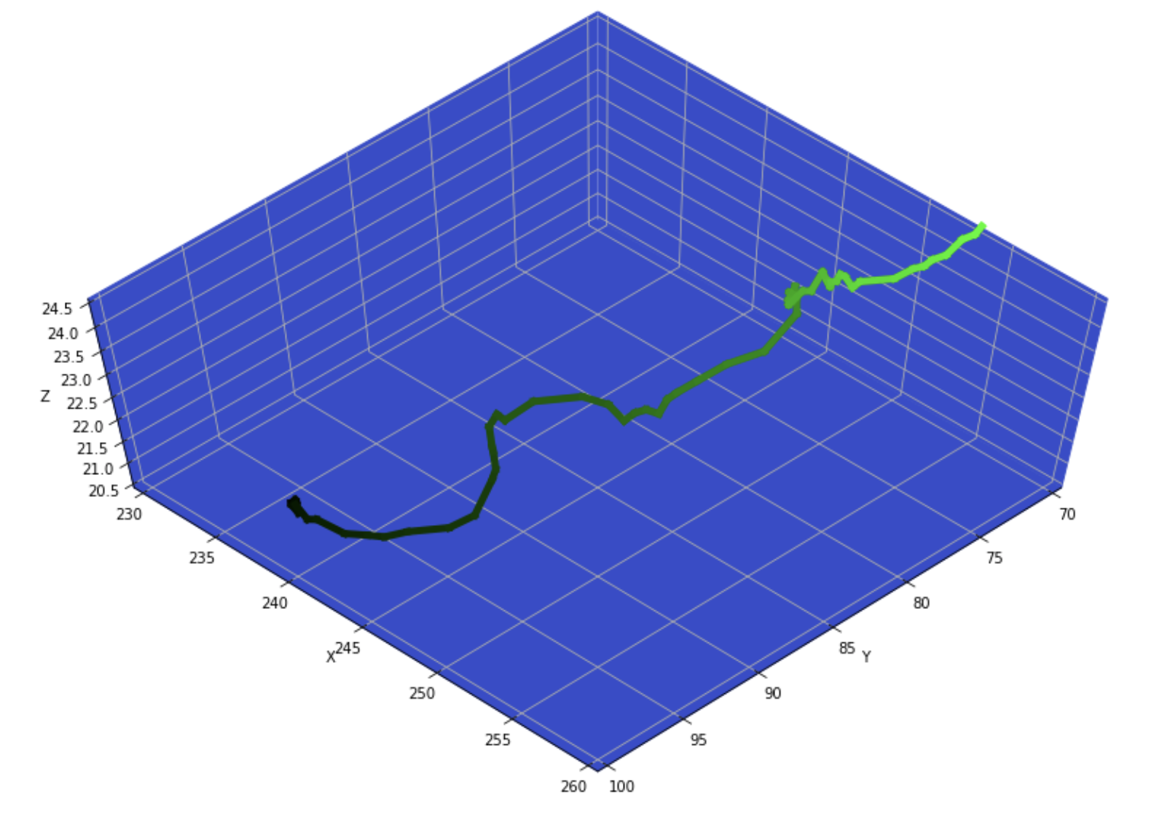

3D Trajectories clustering:
Results

Slide 36
Conclusion and Futurework:
In this research, we developed a computational pipeline for cell tracking and trajectory clustering in 3D microscopic videos. We developed a distributed version of our framework using “Dask Arrays”. The parallel version proves the scalability of the algorithm.
In next steps we plan to concentrate more on three points.
First of all, Using Martin’s Distance instead of RBF
Second, Rebuilding the clustering module using dask, and checking the scalability of the whole algorithm.
Examining and improvement of the dask modules.
Sbmitting the paper on DSAA’ 19
Using convolutional Autoencoders for clustering the trajectories.[ Journal version ]

Slide 37
Thank you !

